Slide 1
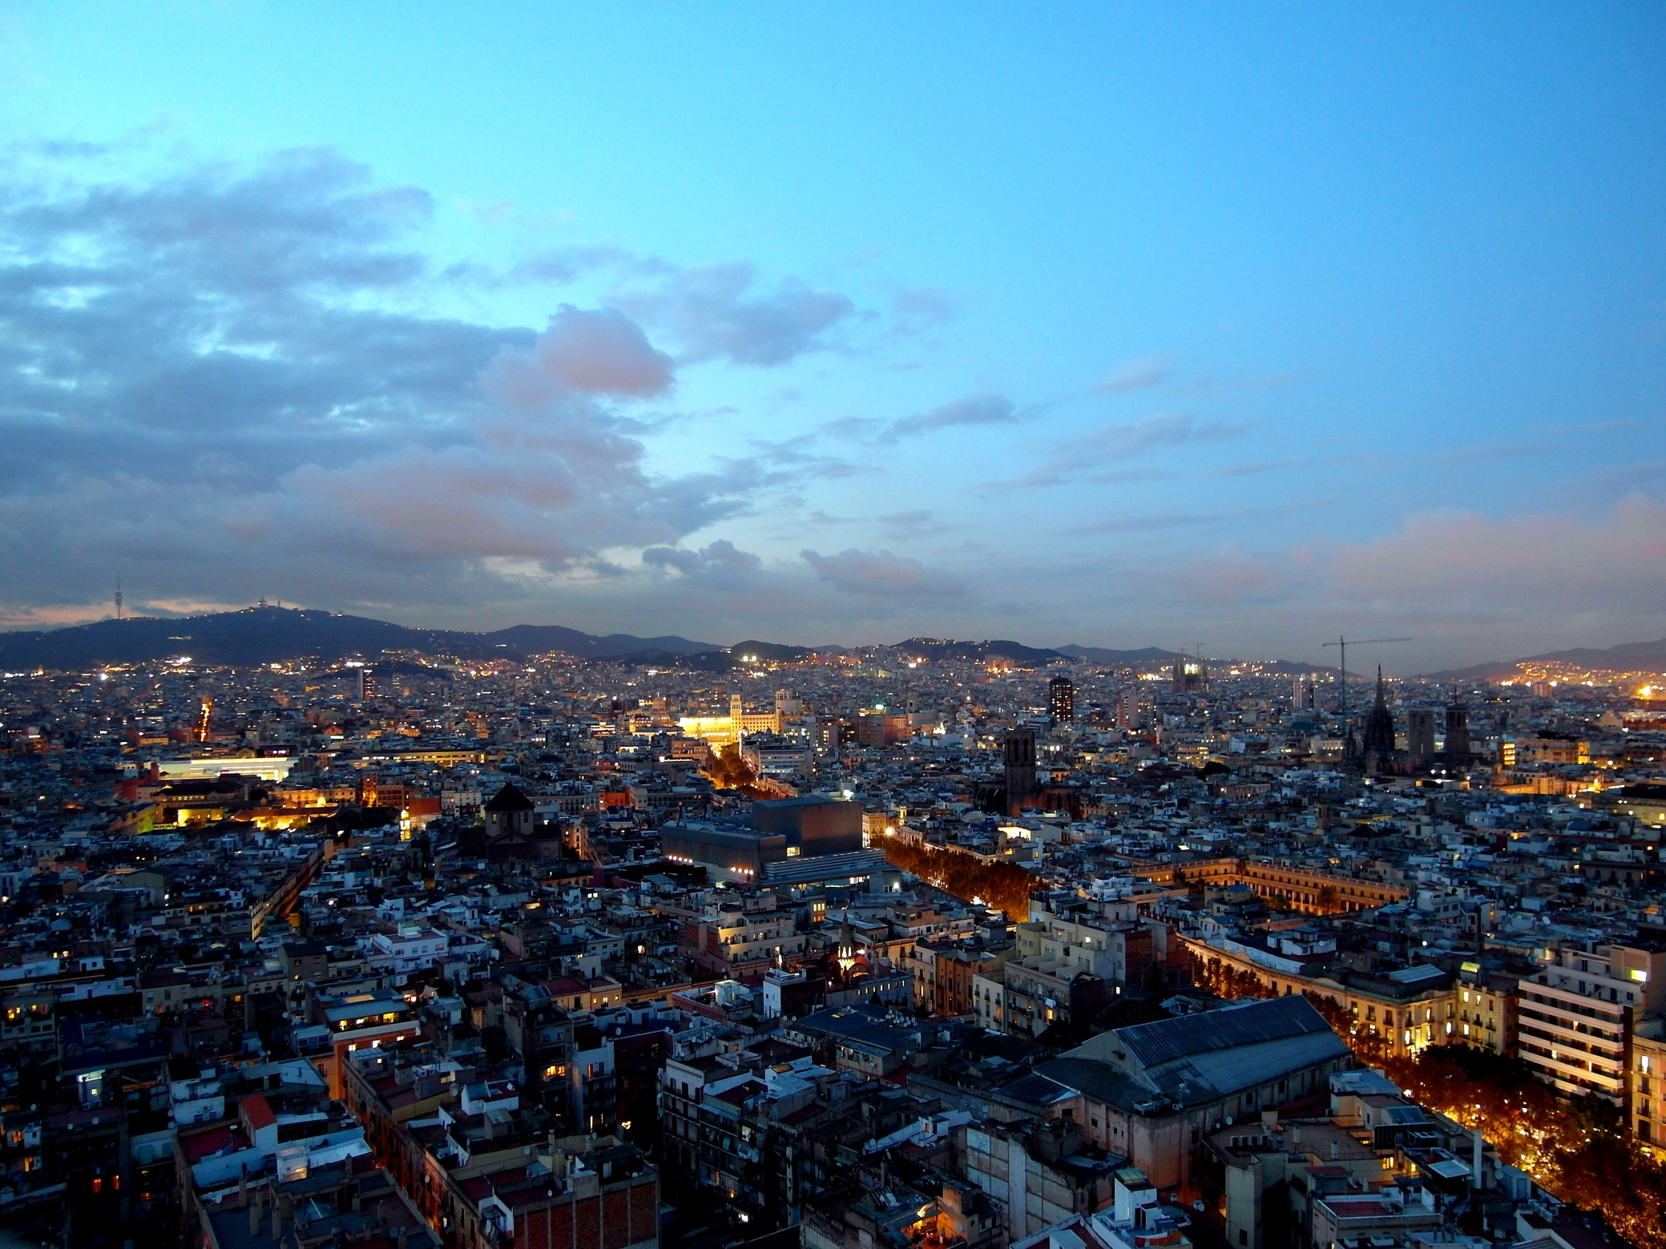
BARCELONA
BUILDING
RESILIENCE STRATEGIES
ARES GABÀS MASIP
Head of Resilience Department

Slide 2
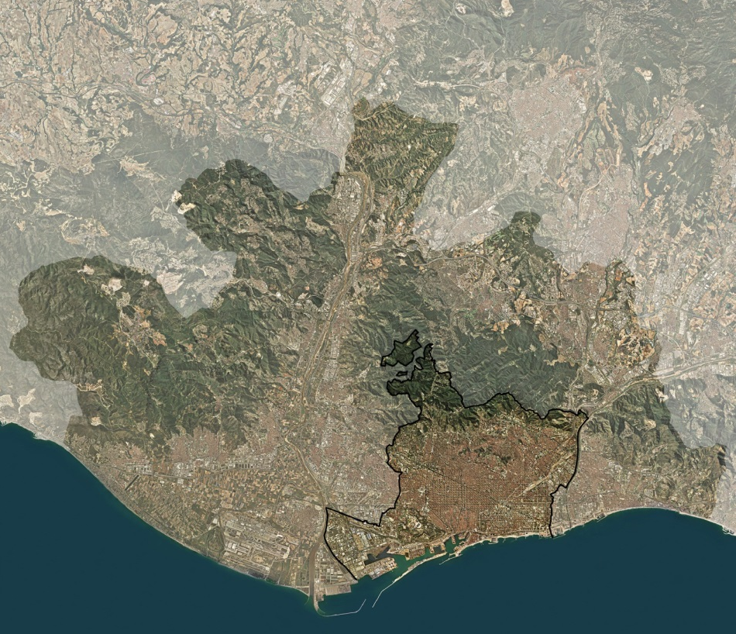

Gestionar la complejidad urbana
alta densidad(1,6 M hab/101km2 - 16.000hab/Km2)
realidad metropolitana (3,2 M hab, 36 municipios)
competencias distribuidas

Slide 3
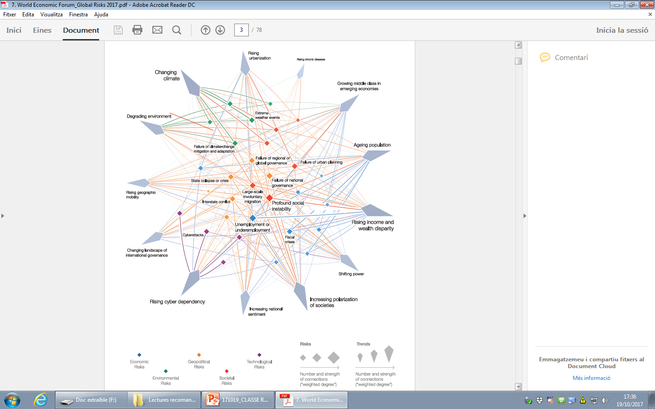
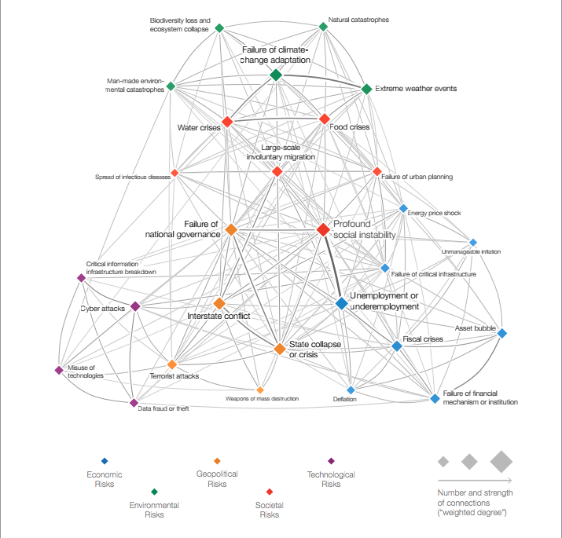
Gestionar la complejidad urbana
mapa de riesgos globales (World Economic Forum)
©World Economic Forum

Slide 4
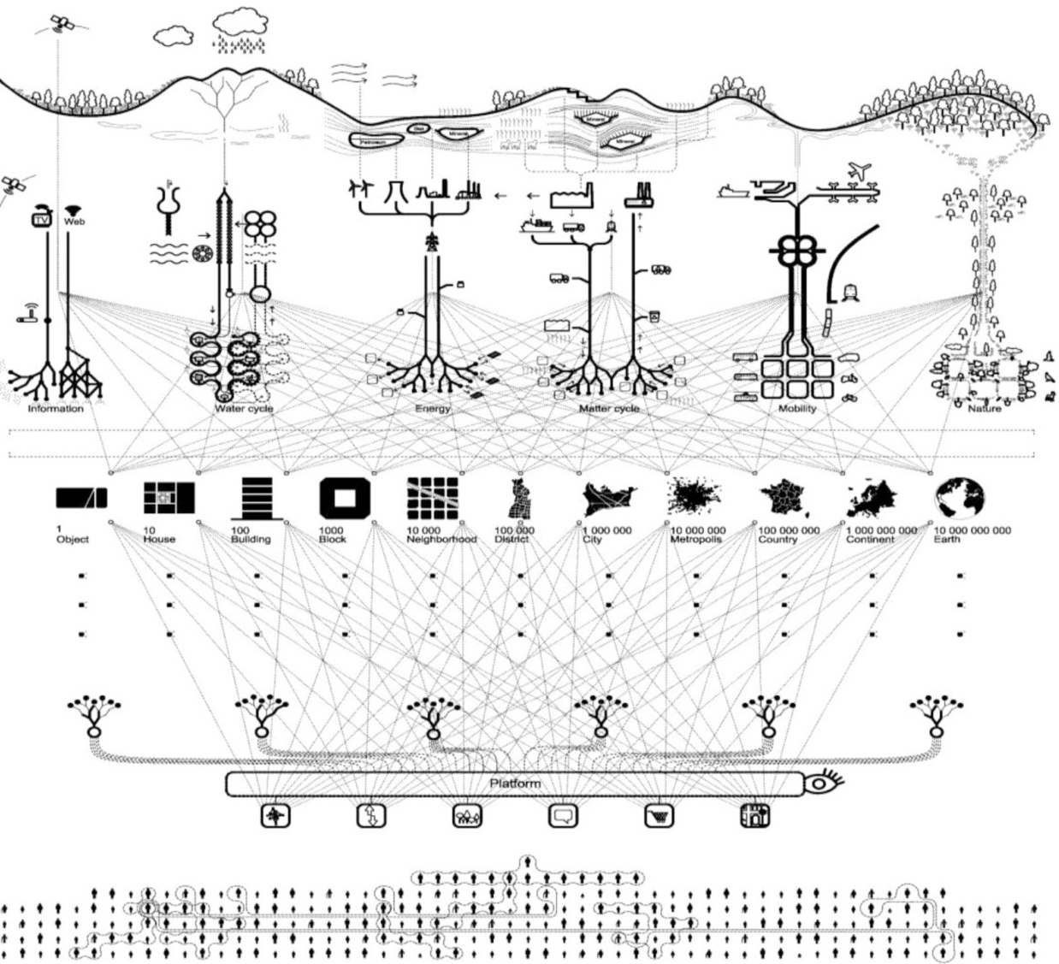
Gestionar la complejidad urbana
la ciudad como sistema de sistemas interconectados
STRUCTURE
INFORMATION
CIVITAS
Environment
Infrastructure
Public space
Nodes
Information
People
housing
industry
offices
shopping
economy
leisure
health
education
culture
sports
administration
security

Slide 5
Gestionar la complejidad urbana
la ciudad como sistema de sistemas interconectados
STRUCTURE
INFORMATION
CIVITAS
Environment
Infrastructure
Public space
Nodes
Information
People
housing
industry
offices
shopping
economy
leisure
health
education
culture
sports
administration
security

Slide 6
Gestionar la complejidad urbana
la ciudad como sistema de sistemas interconectados
STRUCTURE
INFORMATION
CIVITAS
Environment
Infrastructure
Public space
Nodes
Information
People
housing
industry
offices
shopping
economy
leisure
health
education
culture
sports
administration
security

Slide 7
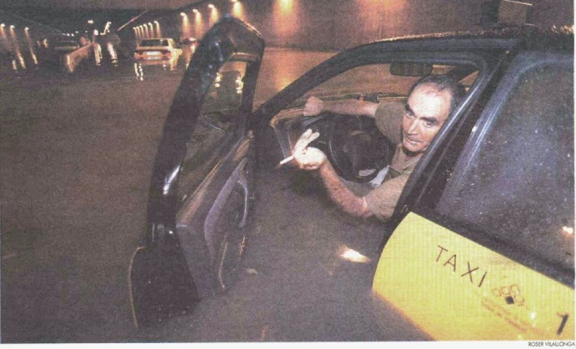
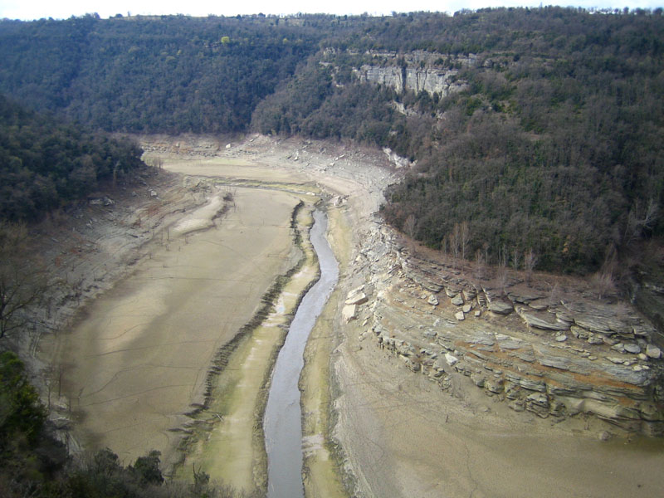
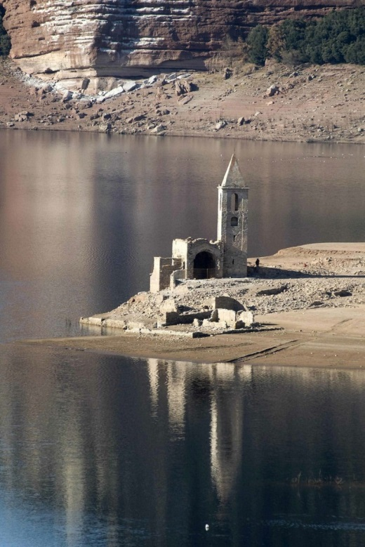
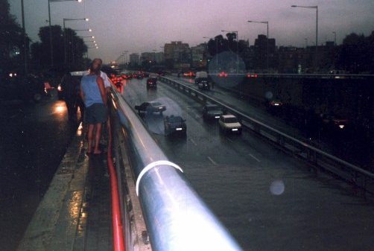
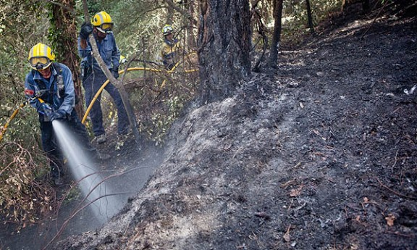
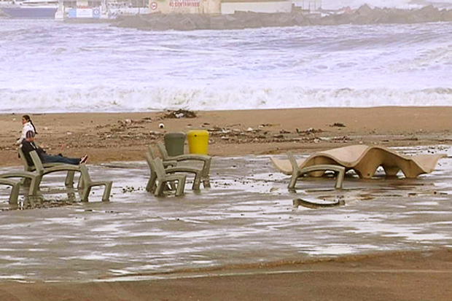
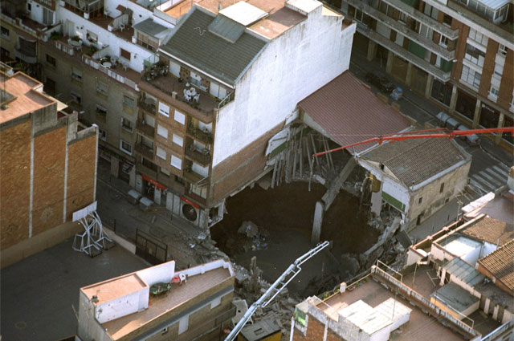
Impactos y tensiones sobre la ciudad. (1a etapa)

Slide 8
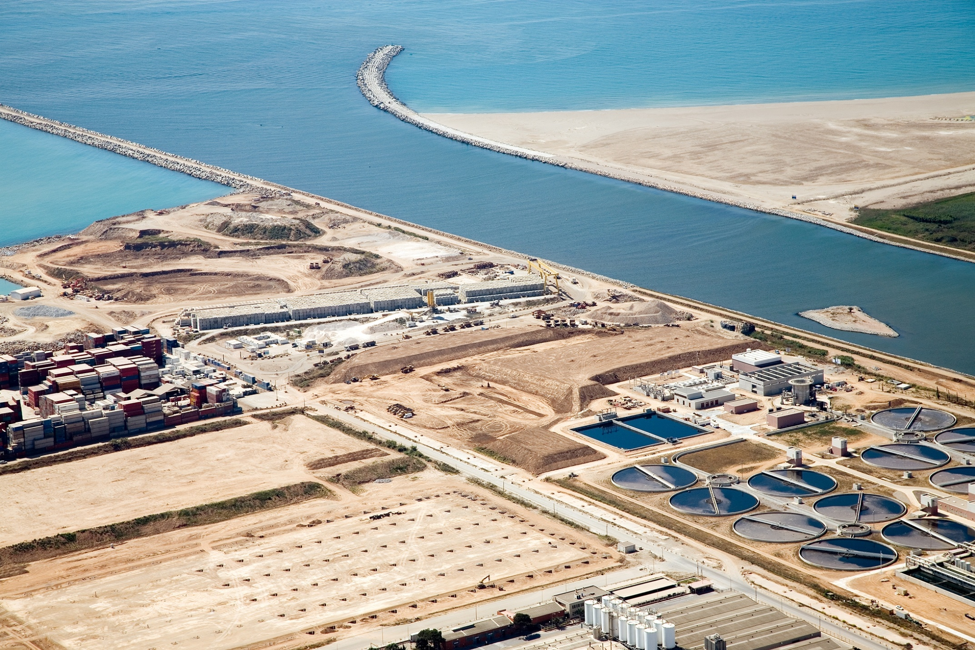
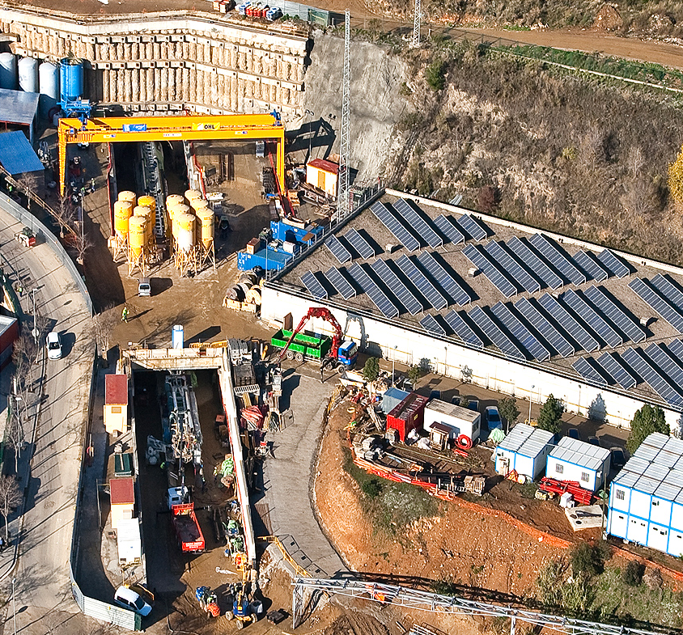
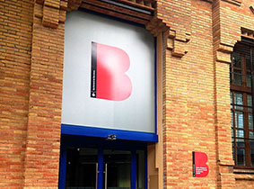
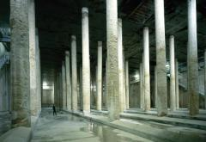
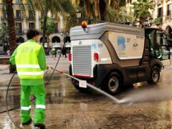
¿cómo hemos respondido?
hasta 2008...
actuaciones sectoriales

Slide 9
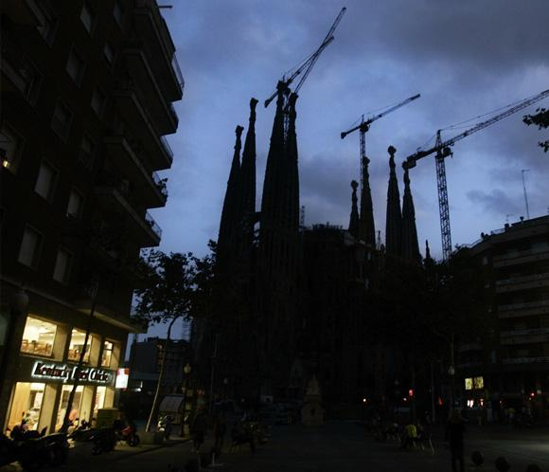
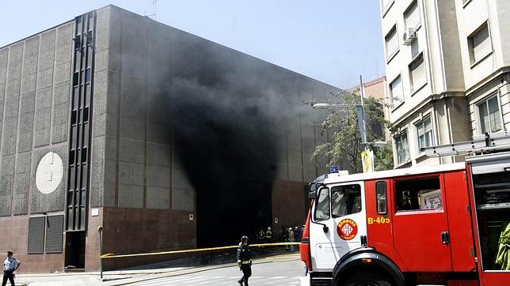
Impactos y tensiones sobre la ciudad. (2a etapa)
Entre 2006 y 2007 Barcelona sufrió una serie de situaciones críticas en un corto espacio de tiempo que pusieron de manifiesto sus vulnerablidades
Problemas con el servicio ferroviario, sequia extrema y un apagón eléctrico masivo que duró más de 3 días*
* 323.337 usuarios afectados durante más de 56h

Slide 10
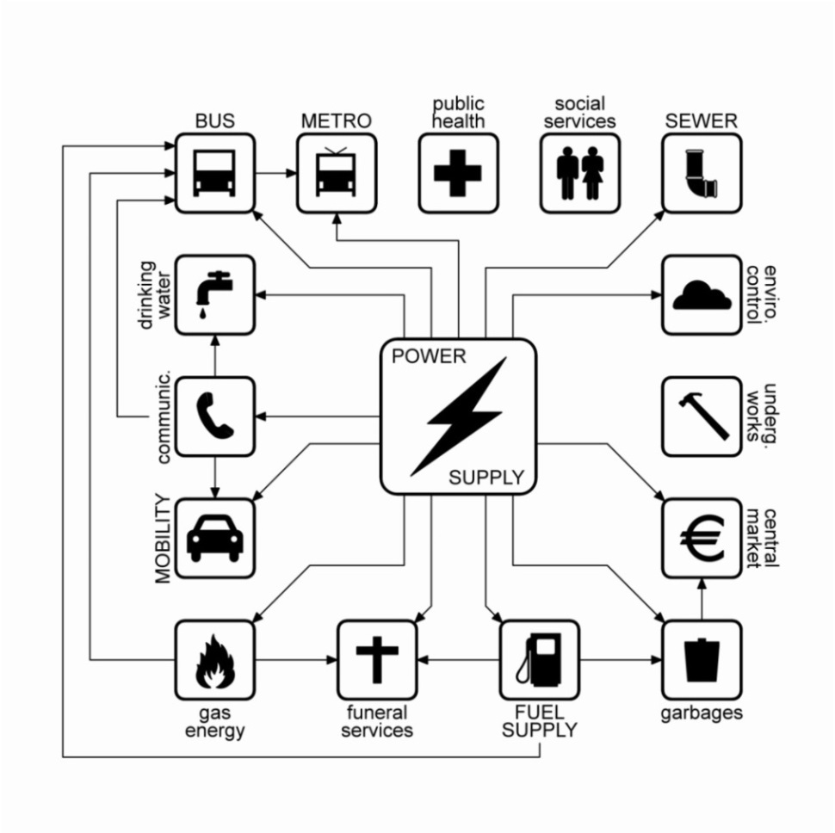
¿cómo hemos respondido?
... a partir de 2008
actuaciones transversales
Diagnóstico:
Analizar vulnerabilidades.
Proyecto 3Ss
Objetivo:
Idenficar los puntos débiles en las infraestructuras y servicios urbanos y los riesgos asociados considerando las interdependencias

Slide 11




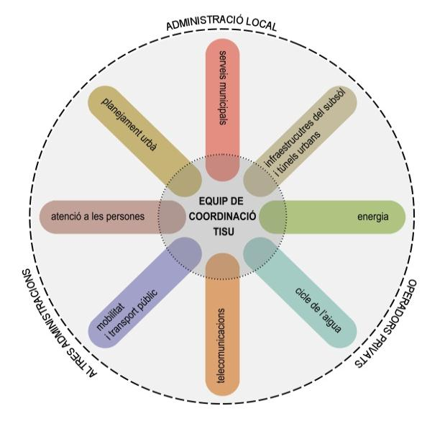
















¿cómo hemos respondido?
... a partir de 2008
actuaciones transversales
Plan de acción
Mesas de resiliencia
Objetivo:
Implementación de proyectos para eliminar o reducir los riesgos detectados:
! Involucración actores clave
! Trabajo intersectorial
+ de 20 entidades (públicas+privadas)
+ de 70 profesionales
1 equip de coordinación

Slide 12
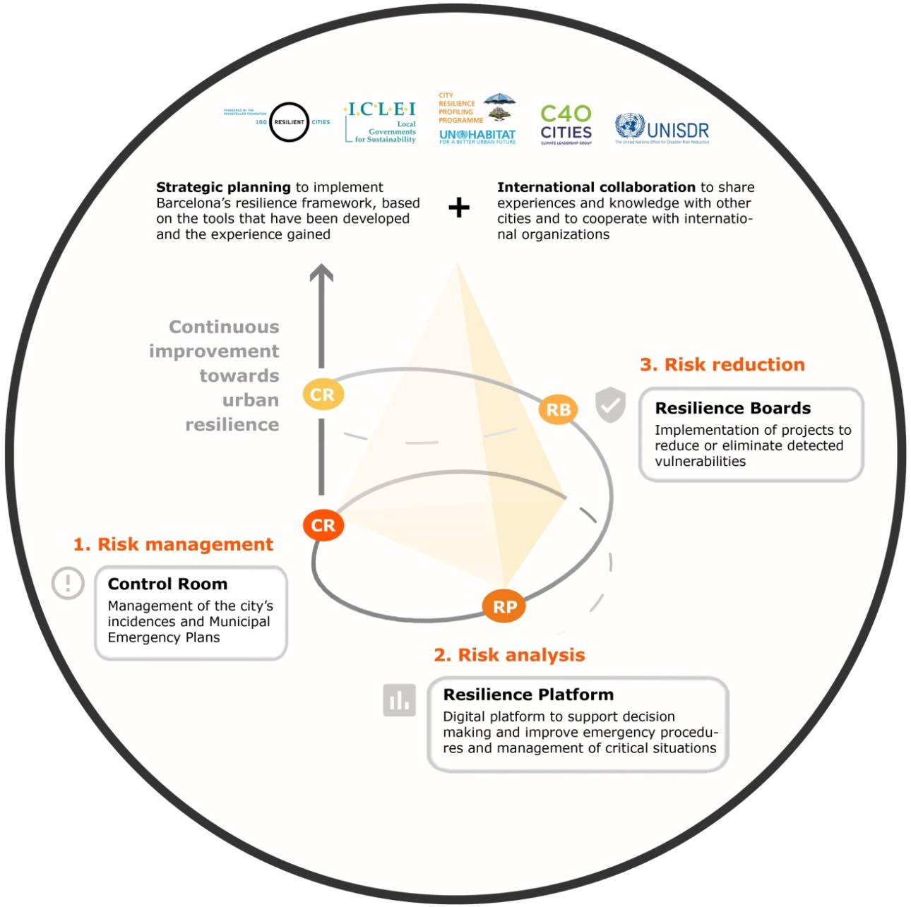

2014. Institucionalización
Creación del departamento de resiliencia urbana
visión de ciudad
Resilience strategy
[estrategia]
[gestión]
Respond
Implement
[operación]
implementación
Assess

Slide 13

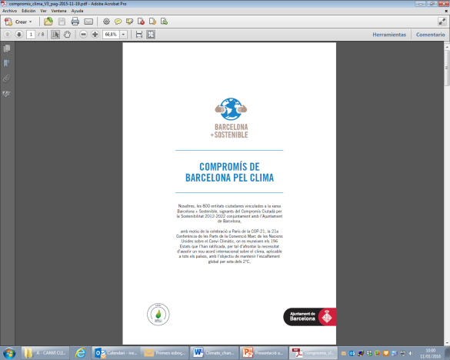

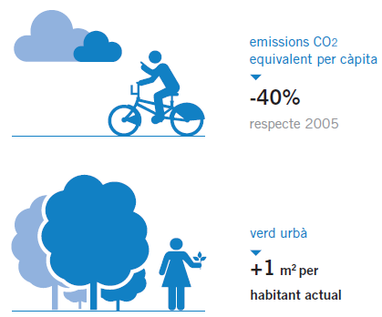

ESTRATEGIA DE RESILIENCIA URBANA
Climatic risks: ADAPTATION
Technological risks
Socioeconomical risks
MITIGATION
CLIMATE PLAN
SOCIAL EQUITY
CITIZEN ACTION

Slide 14


ESTRATEGIA DE RESILIENCIA URBANA
Structure of the Climate Plan
SCOPE:
Temporal: LONG TERM 2030.
Territorial: MULTISCALE
Competence: MULTILEVEL AND HOLISTIC
Clear and inclusive plan.
Concept
Monitoring
indicators, responsibility,
budget, etc.
Main areas
Strategic goals
Lines of action

Slide 15
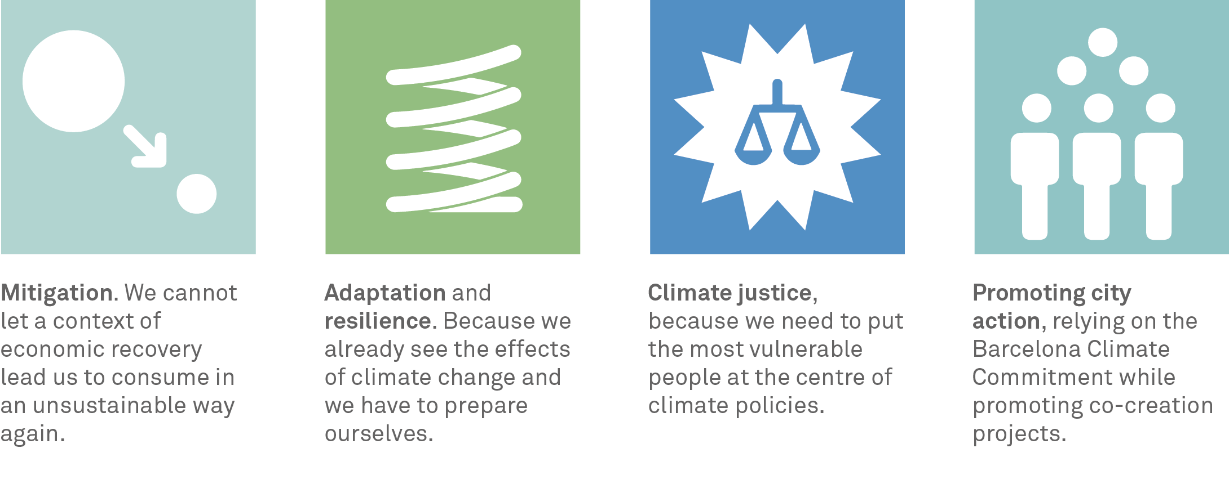
ESTRATEGIA DE RESILIENCIA URBANA
Main areas and strategic goals
⬇45% lower GHG emissions than in 2005
20% of residential building stock (>40 years old) improved in energy terms
x5 solar power generation
⬇20% private motor mobility
⬆1 m²
more green area
per inhabitant
100 l/inhabitant/day domestic water consumption
0
Energy poverty
€1.2m
in direct subsidies for public projects
Notes:
Barcelona socialment justa, que implementa polítiques i mesures considerant la diversitat socioeconòmica, de gènere, territorial i cultural de la seva ciutadania.
Barcelona habitable i segura, que permet viure de manera confortable, amable, cohesionada i que genera espais segurs i adequats per a tothom.
Barcelona saludable, on es respira un aire net, es promou una vida activa, es gaudeix d’espais públics de qualitat i on es demostra que viure a Barcelona no és sinònim de renunciar a una bona salut.
Barcelona eficient i renovable, amb una mobilitat sostenible i que aprofita bé els seus recursos.
Barcelona baixa en carboni i distributiva, que no depèn tant dels combustibles fòssils ni per generar energia ni per generar productes i serveis, i on els beneficis es distribueixen entre els seus habitants.
Barcelona que aprèn, que cada dia assaja solucions i no perd la memòria; que avança i millora dia a dia sabent, però, que encara li queda molt per aprendre.
Barcelonins/nines compromesos/ses, que tenen clar que amb la seva actitud poden canviar la realitat i i protegir el futur per a les generacions futures.

Slide 16



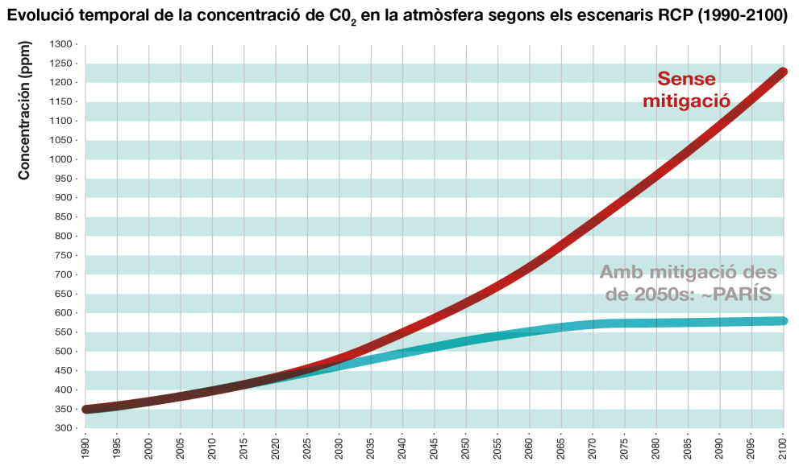
ESTRATEGIA DE RESILIENCIA URBANA
CLIMATE PROJECTIONS. How climate change affects Barcelona
DOWNSCALING Based on ESAMB Project (Downscaled climate scenarios in the Barcelona Metropolitan Area)
PASSIVE scenario
If we don’t make an effort to mitigate the effects of climate change.
Current
Average temperature: 17.6ºC
Average rainfall: 600 mm
Passive scenario:
+2ºC by mid-century
+3º C by end of century
- 26 % of average annual rainfall by end of century
Committed scenario:
+1.6ºC by mid-century
+1.7ºC by end of century.
-14% of average annual rainfall by end of century
+ Frequency of dry periods and downward trend in average annual rainfall
+ Intensity of rain and concentration of extreme episodes
Evolution in the concentration of CO2 in the atmosphere over time, according to RCP scenarios (1990-2100)
Without mitigation
Concentration (ppm)
With mitigation from the 2050s: ~PARIS
COMMITTED scenario
If we comply with the Paris agreements.

Slide 17
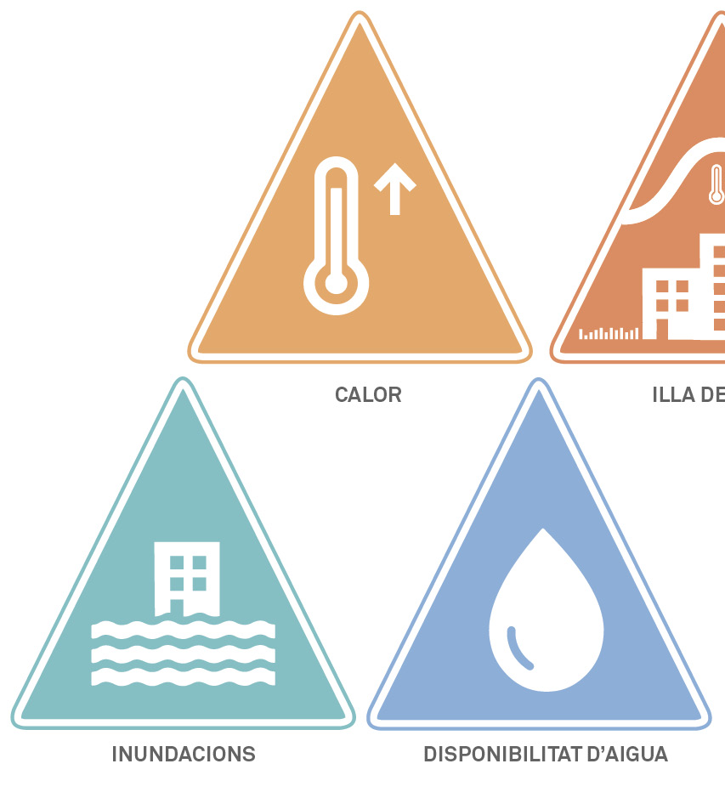
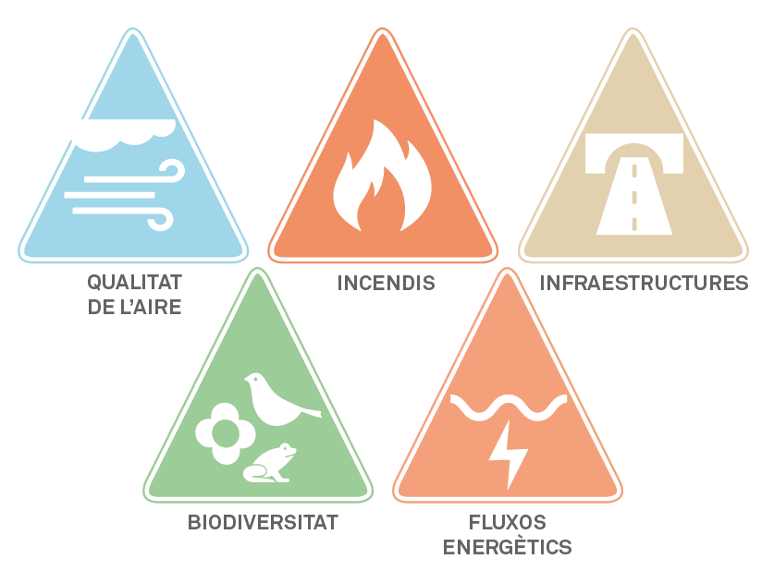

ESTRATEGIA DE RESILIENCIA URBANA
CLIMATE PROJECTIONS. How climate change affects Barcelona
VULNERABILITY ASSESSMENT

Slide 18
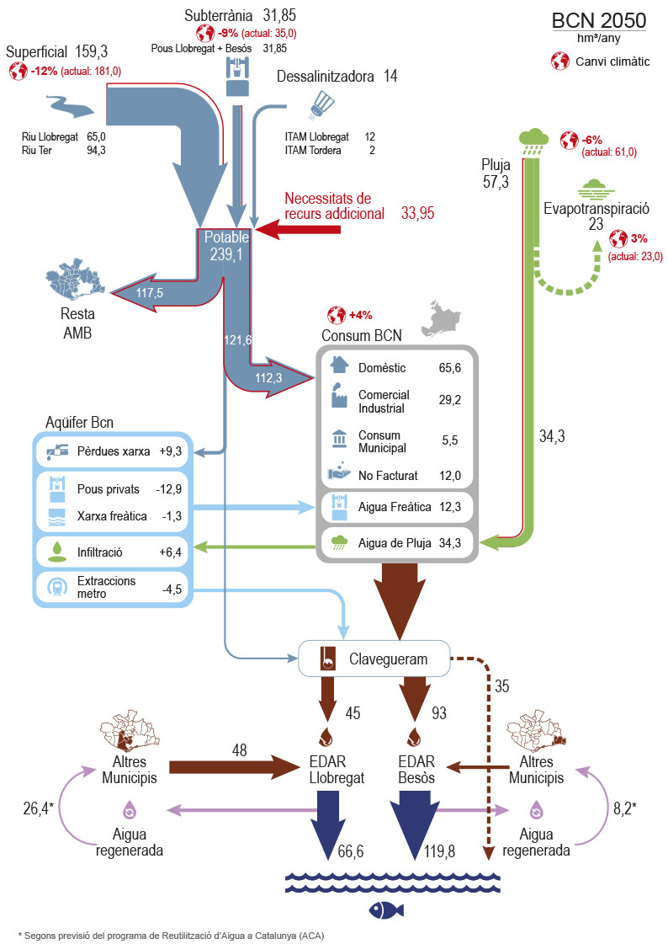

ESTRATEGIA DE RESILIENCIA URBANA
  WATER CYCLE ANALYSIS
We expect a slight reduction in water resources, greater variability in its availability and an increase in demand.
There is already a deficit in the water supply system, as ever four years the resources are less than or very close to the level of demand
Guaranteed supply only one year
Climate change and global change affect the available resources
IN BCN we need 18hm3 additional resources by 2050
It will be necessary to use alternative water resources.
Notes:
The city currently suffers a deficit in its water supply system, as the resources are less than, or very close to, the level of demand one year out of every four.
This is gradually being resolved with the reservoir reserves of previous years, but the guaranteed supply is only for one year.
We expect a slight reduction in water resources, greater variability in its availability and an increase in demand. Specifically, by 2050 there will be a need for an additional 18 hm³/year of potable water resources.
Underground 31.85
-9% (current: 35.0)
Llobregat + Besòs wells 31.85
Surface 159.3
-12% (current: 181.0)
River Llobregat 65.0
River Ter 94.3
Desalination plant (ITAM) 14
ITAM Llobregat 12
ITAM Tordera 2
Additional resource needs
Potable
239.1
Other
Barcelona Metropolitan Area (BMA)
Bcn Aquifer
Grid losses
Private wells
Phreatic network
Infiltrations
Metro extractions
Domestic
Commercial Industrial
Municipal Consumption
Not invoiced
Groundwater
Rainwater
Sewage system
Other Municipalities
Regenerated water
EDAR Llobregat
EDAR Besòs
Other Municipalities
Regenerated water
Consumption BCN
BCN 2050
hma/year
Climate change
Rain 57.3
-6%
(current: 61.0)
Evapotranspiration 23
3% (current: 23.0)
* According to the Reuse of Water in Catalonia (ACA) programme

Slide 19

ESTRATEGIA DE RESILIENCIA URBANA
Principles of the plan
BARCELONA ACCEPTS RESPONSIBILITY FOR ITS CONTRIBUTION TO CLIMATE CHANGE AND IS GEARING UP TO BE LESS VULNERABLE TO ITS EFFECTS
MISSION:
To reduce Barcelona’s contribution to climate change
To anticipate climate risks in order to ensure the city’s functionality and improve its response capacity
To reduce people’s vulnerability to climate change, thereby ensuring their health and well-being
VISION:
A proactive city that adopts a comprehensive approach to tackling the challenge of climate change and assumes its responsibility in that regard; a city that can create opportunities from difficulties and adapt to new climate conditions intelligently, generating co-benefits for people and socio-economic activity.

Slide 20
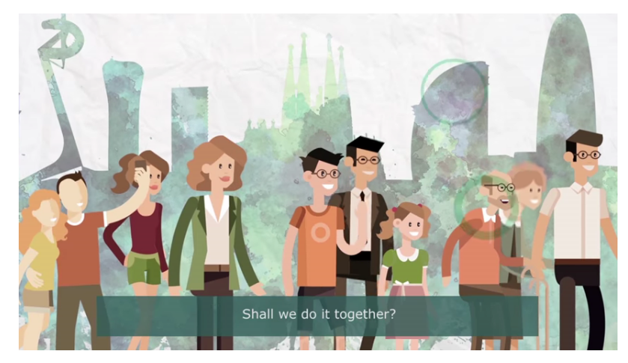
ESTRATEGIA DE RESILIENCIA URBANA
CO-PRODUCTION PROCESS

Slide 21

ESTRATEGIA DE RESILIENCIA URBANA
CO-PRODUCTION PROCESS
July
Fase 1. Presentation
Fase 2. Proposals
Fase 3. Debate
Fase 4. Feed-back
External participation process
CO-PRODUCTION CLIMATE PLAN
“Barcelona’s Decidim” Platform
Space of participation open to all citizens Instructions for making contributions Videos Information for face-to-face meetings Space to make proposals Support documentation > 100 PROPOSALS RECEIVED
July-September
October
+ 2 Monitoring committee meetings (METAPARTICIPATION)
January

Slide 22
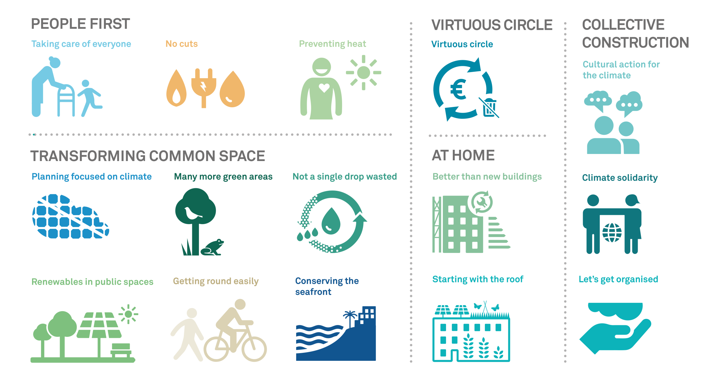
ESTRATEGIA DE RESILIENCIA URBANA
PROPOSED LINES OF ACTION

Slide 23
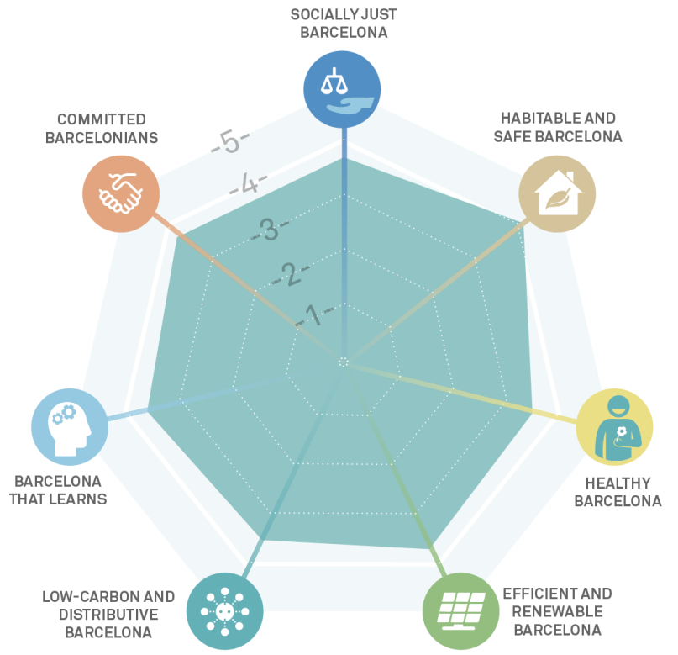
Proposed lines of action
STRUCTURE
Global values of the Climate Plan:
Justification and benefits
Description
  Existing plans and measures
  New short-term measures
  New medium and long-term measures
  Illustrative action
Municipal players involved
Strategic areas
Values
Budget (pending)
Monitoring indicators

Slide 24
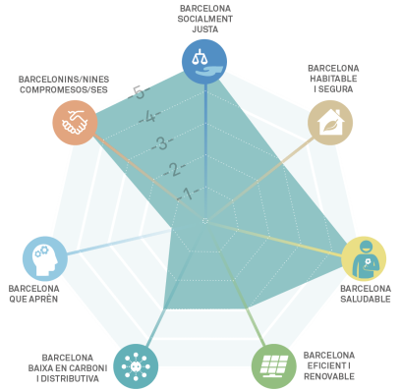
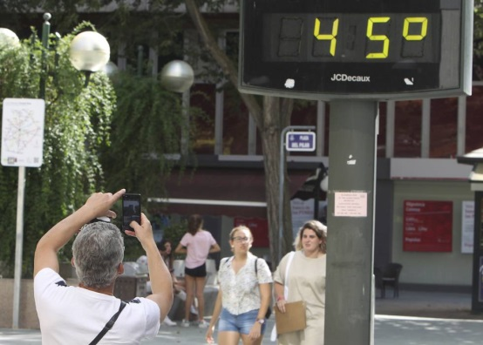
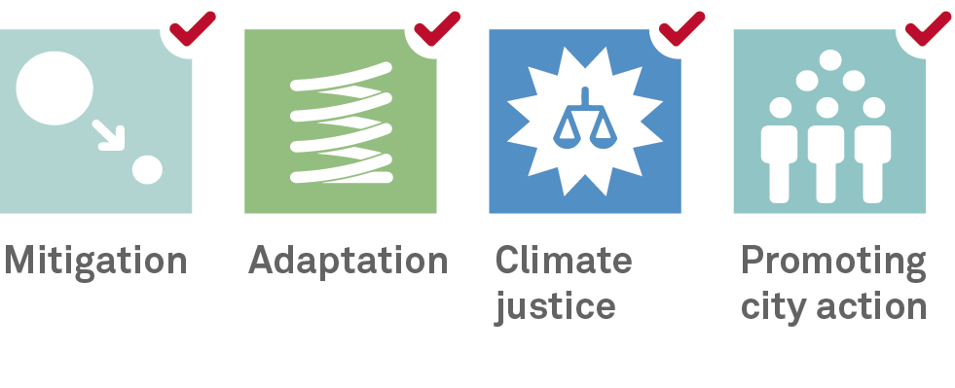
Taking care of everyone
Illustrative action: Action protocols for heatwaves, in order to protect the most vulnerable people.
Heatwave action-protocol prevention stages are automatically triggered to:
Inform and train professionals.
Publicise recommendations for avoiding the effects
Update the census of vulnerable people, plus the list of care resources and air-conditioned day centres.
Establish a permanent telephone service, etc.
IMPROVING AND ADAPTING SERVICES,
FACILITIES AND HOUSING FOR THE MOST VULNERABLE PEOPLE IN THE FACE OF CLIMATE CHANGE

Slide 25

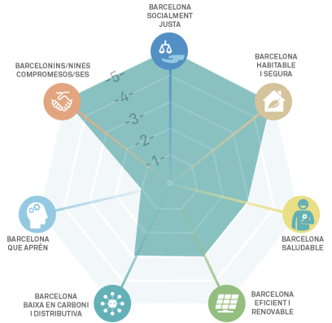

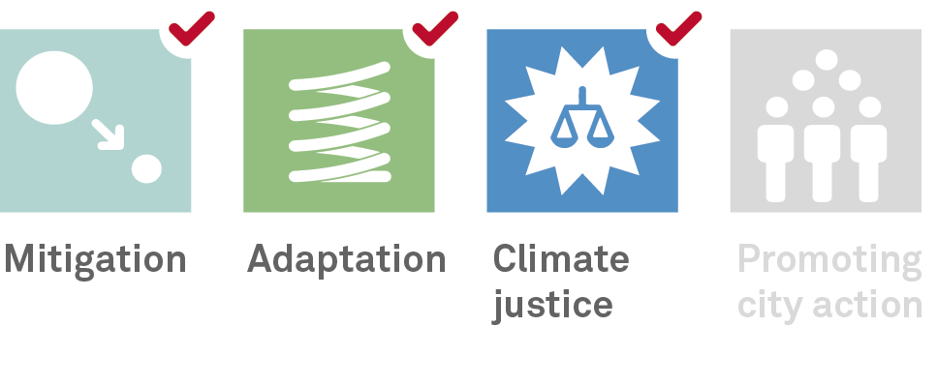

No cuts
Illustrative action: Barcelona City Council Energy Advice Points.
Energy Advice Points are a City Council service offering the information, support and intervention people need, so that they can exercise their energy rights and companies cannot deny them access to basic supplies.
They also offer the general public advice on applying for the special discount on their bill, plus subsidies for improving energy efficiency in the home and reducing energy bills.
GUARANTEEING BASIC POWER SUPPLIES FOR EVERYONE. ENSURING THAT THE MOST VULNERABLE PEOPLE DO NOT HAVE THEIR POWER AND WATER SUPPLIES CUT OFF WHILE PROMOTING LOCAL ENERGY PRODUCTION ADAPTED TO THEIR NEEDS

Slide 26

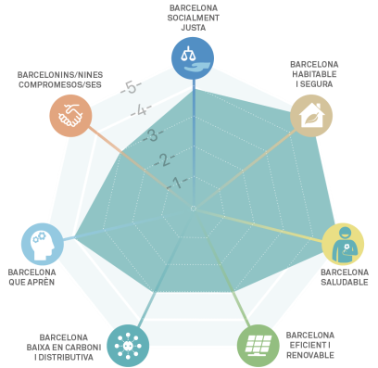
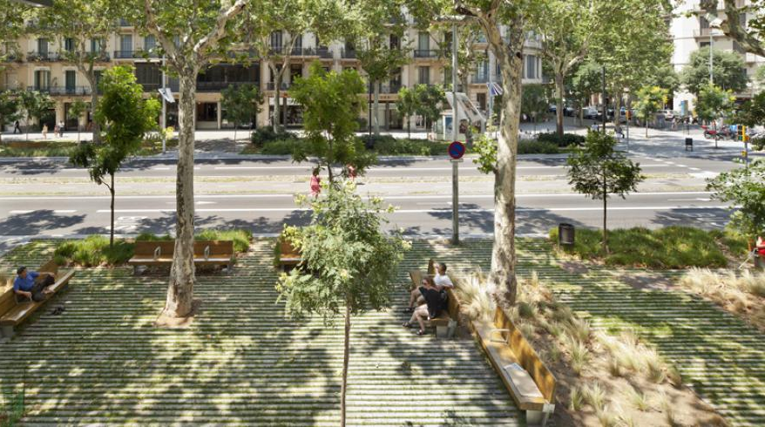
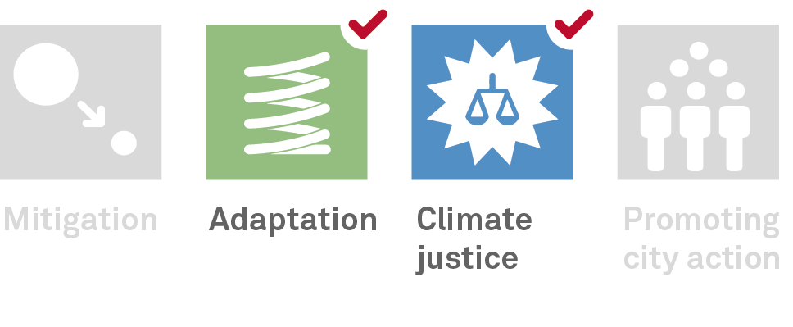
Preventing heat
Illustrative action: Transformation of Passeig de Sant Joan
The green infrastructure on this boulevard consists of two new lines of trees on both sides of the century-old trees already in place, forming a cooler area with natural shade.
Shrubs and herbaceous plants have also been introduced, which encourage the presence of fauna.
There are also recreational areas, children’s play areas and bar terraces which, combined with the heat-regulating effect of the vegetation, help to increase thermal comfort in this public area.
IMPROVING THERMAL COMFORT IN THE CITY'S PUBLIC AREAS AND BUILDINGS AND CREATING A NETWORK OF CLIMATE SHELTER SERVICES IN RESPONSE TO HIGH TEMPERATURES, TAKING SPECIAL CARE OF THE MOST VULNERABLE GROUPS

Slide 27

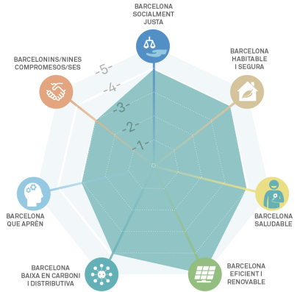
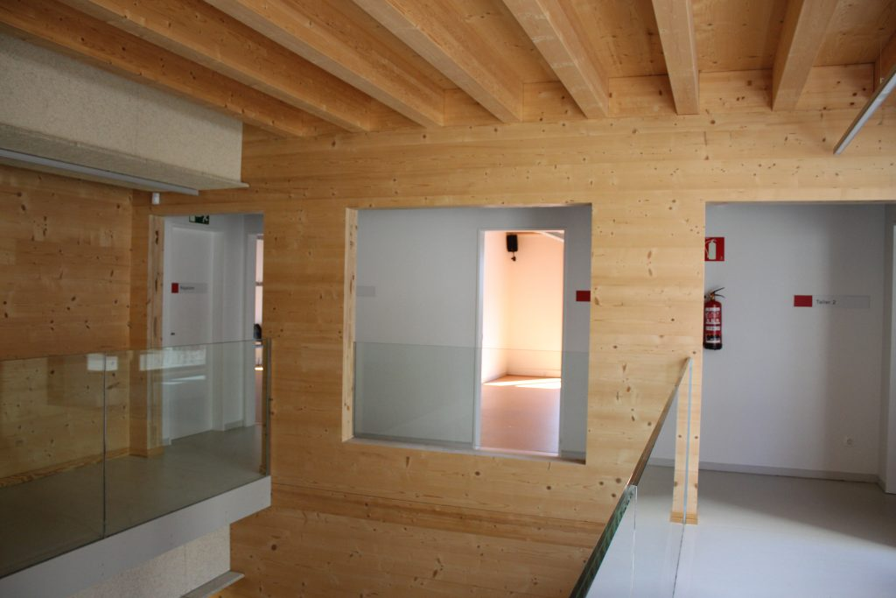
Better than new buildings
Illustrative action: Can Portabella, a renovated facility with a positive energy balance
The renovation of this building was based on energy efficiency criteria:
Use of wood, which ensures warmer temperatures in winter and cooler in summer.
Large window and inner patio that lets natural light into all the rooms practically all day.
Ventilated roof with photovoltaic panels.
Battery-operated lift which enables big savings.
STEPPING UP ACTIONS TO IMPROVE ENERGY EFFICIENCY IN BUILDINGS, DWELLINGS AND FACILITIES, IN ORDER TO REDUCE ENERGY DEMAND, OPTIMISE ENERGY CONSUMPTION AND FOSTER SELF-CONSUMPTION, PROGRESSING TOWARDS ZERO-CONSUMPTION BUILDINGS.

Slide 28

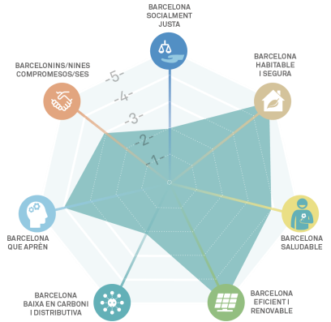
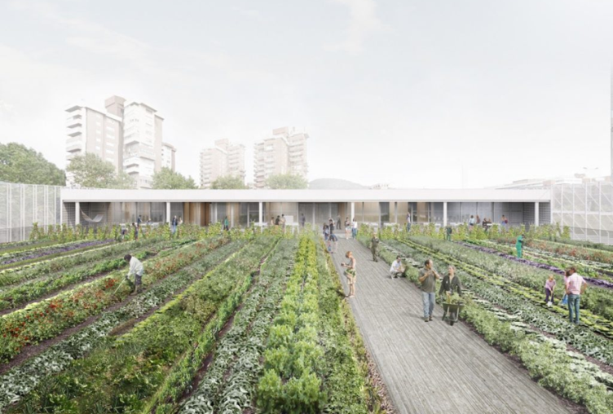
Starting with the roof
Illustrative action: Agriculturally-productive green rooftop at the Mercat de la Vall d’Hebron-Teixonera
Remodelling the market (with a municipal investment of €10 million) consists of increasing the building's volume, redesigning the basement and ground floor and redeveloping the market's surroundings. It will also include a agriculturally-productive green roof covering 1,400 m2.
Efforts are being made to get a social organisation to run it, through the Employment Promotion Network set up by the Horta-Guinardó District Council.
Project coordinated by the Barcelona Municipal Institute of Markets and the District.
PROMOTING ROOFTOPS AND FACADES THAT PROVIDE SOCIO-ENVIRONMENTAL SERVICES WITH ADDED VALUE

Slide 29

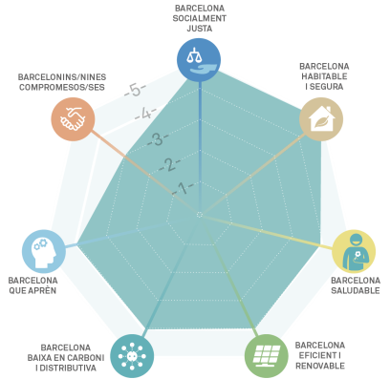
Planning focused on climate
Illustrative action: Reclaiming 100,000 m2 of public space in Eixample city-block interiors.
48 block interiors have already been reclaimed and made available to local residents (2017). The project to reclaim these spaces began in 1987. The aim was for people to have a green area within 200 metres of their homes.
They are local areas providing opportunities that foster social cohesion (they are often linked to facilities and provide children’s recreation areas), health (some are equipped with keep-fit areas for elderly people), leisure and even cooling down (some have incorporated small urban beaches). This required specific amendments to the General Metropolitan Plan.
INCORPORATING THE CLIMATE VARIABLE IN URBAN PLANNING

Slide 30

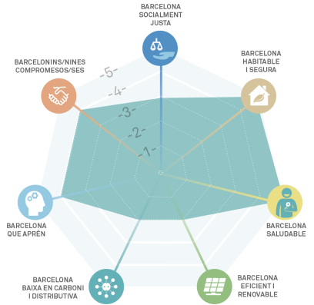
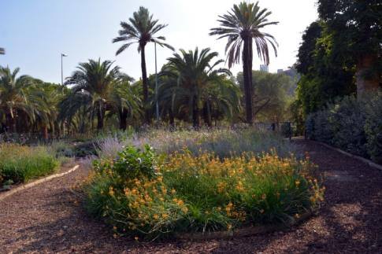
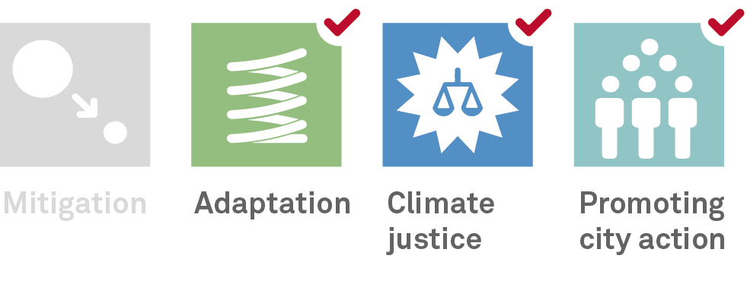
Many more green areas
Illustrative action: Parc de Joan Miró, which includes an area of special interest for biodiversity
This 448 m2 area encourages the presence of wildlife by means of carefully selected nectariferous plants, which provide food for certain species of butterflies and other pollinators. Small rockeries and tree trunks also offer shelter and feeding possibilities to birds, insectivores and other beneficial species of fauna.
Almost 99% of the garden is made from organic material, while the remaining 1% is for sprinklers and footpaths, so people can walk through the garden without treading on planted areas.
ACHIEVING ANOTHER 1.6 KM² OF GREEN SURFACE AREA
AND PRESERVING SPECIES THAT ARE VULNERABLE TO CLIMATE CHANGE

Slide 31

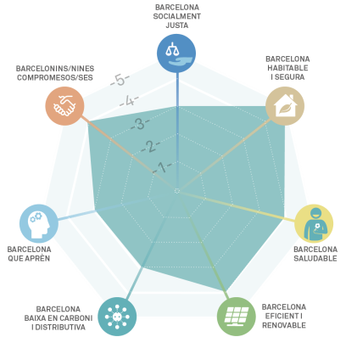
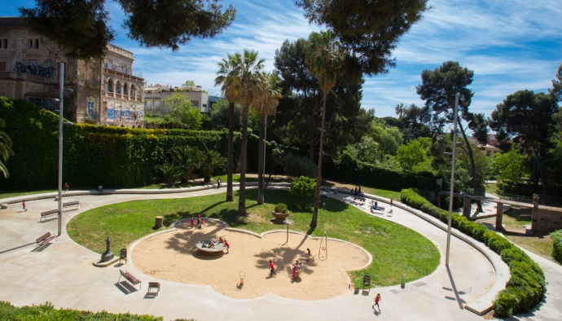
Not a single drop wasted
Illustrative action: Parc de Joan Raventós, a green area that absorbs rainwater.
Parc de Joan Raventós, in the Sarrià neighbourhood, has a surface area of 20.000 m2and it was opened in 2009 following the reclamation of the old Riera de les Monges dry riverbed. Built with an innovative, sustainable drainage system, it collects rainwater through various kinds of surfacing, which filter the water while purifying it, so that it eventually reaches the subsoil. In the event of a downpour, the water is kept in the retention area or anti-flooding areas created for that purpose.
CLOSING THE WATER CYCLE AND OPTIMISING THE USE OF PHREATIC WATER, PROMOTING USES OF RAIN AND REGENERATED WATER AND FACILITATING WATER INFILTRATION INTO THE SUBSOIL

Slide 32




Renewables in public spaces
Illustrative action: Photovoltaic pergola over a children’s play area in Barcelona's Plaça del Centre.
A pergola has been built over a children’s play area and, in addition to providing shade,it generates electricity from the sun’s energy.
It has photovoltaic panels that supply up to 12,48kWp of installed power. It is connected to a system of lithium-ion batteries and supplies 70% of the square’s annual lighting needs. When the energy stored in the batteries proves insufficient, the lights are powered directly from the electricity grid.
FOSTERING THE INSTALLATION OF SOLAR POWER FACILITIES IN PUBLIC AREAS BY MEANS OF NEW STRUCTURES OR TRANSFORMING EXISTING URBAN STRUCTURES

Slide 33



Getting around easily
Illustrative action: Expanding the cycling infrastructure, as one of the main goals for implementing the measures set out in the 2013-2018 Urban Mobility Plan.
The target is to have 308 km of cycle lanes by 2019, which means an increase of 165% on 2015. In this way, 95% of the city's population would have a cycle lane within 300m of their homes.
130 actions are planned in streets and other locations to achieve the full deployment of the cycle lane network. In most cases, new cycle lanes will be created, although in some places, streets will be improved or signage introduced for cycling (30 kph zones) and cycle routes.
TAKING ACTION WITH REGARD TO PUBLIC AREAS AND MOBILITY TO FOSTER COMMUNITY LIFE, SOCIAL COHESION, WELL-BEING AND PUBLIC HEALTH

Slide 34



Conserving the seafront
Illustrative action: Transferring sand from the Port Olímpic entrance to Barcelona’s beaches, as part of the PGIL
The Comprehensive Coastline Management Plan (PGIL) determines how the city’s beaches are managed and establishes a joint working framework for all the players involved. It provides for the transferring of sand trapped by sports marina structures along the Maresme coastline to more westerly beaches and the annual dredging of sand deposited at the Port Olímpic entrance to benefit the Somorrostro and Barceloneta beaches. (Around 8,000 m3 are transferred every year.)
MAINTAINING AND MAKING THE MOST OF THE ENVIRONMENTAL SERVICES OFFERED BY THE SEA AND THE COASTLINE TO COMBAT CLIMATE CHANGE. ENSURING THE FUNCTIONAL INTEGRITY OF THE COASTLINE.

Slide 35



Virtuous circle
Illustrative action: DIY repair workshops
Repair workshop programme for civic centres and neighbourhood centres designed to provide people with the knowledge they need to repair their own electronic devices and small household electrical appliances.
REDUCING THE CITY’S MATERIAL AND ENERGY CONSUMPTION BY PROMOTING A REDUCTION IN WASTE AND ITS REUSE

Slide 36



Cultural action for the climate
Illustrative action: Specific call for subsidies for public climate projects.
The purpose of these subsidies is to provide financial backing for projects that promote a reduction in greenhouse-gas emissions, adapting the city to climate change and/or climate justice.
A notable feature is that these must be cooperative projects involving at least three organisations, one of which acts as leader, and they may be subsidised by up to 80%, with a maximum of €20,000 per project.
The 2018 budget for these subsidies is €200,000.
SPREADING CLIMATE CULTURE TO ALL THE CITY'S NEIGHBOURHOODS AND DEALING WITH THEIR SPECIFIC PROBLEMS. FOSTERING CLIMATE CULTURE AND PROMOTING PUBLIC TRAINING IN REDUCING EMISSIONS AND ADAPTING TO CLIMATE CHANGE

Slide 37



Climate solidarity
Illustrative action: The City Council is taking part in the Clean CO2 project in Brazil, aimed at converting from fossil fuel to biomass
RAISING PUBLIC AWARENESS OF THE EFFECTS OF CLIMATE CHANGE CAUSED BY BARCELONA ON MORE VULNERABLE COUNTRIES AND SOCIETIES, AND MAKING PROGRESS ON REDUCING THE CITY’S ECOLOGICAL DEBT
The Brazilian company Ceràmiques GE Teobaldo manufactures red ceramic products and, thanks to this project, it now uses renewable biomass to generate energy, instead of native wood.

Slide 38



Let’s get organised
Illustrative action: The urban resilience information and analysis platform aims to provide a comprehensive overview of the city, by bringing together all the critical or relevant information gathered from the various systems involved.
INCORPORATING CHANGES ON AN ORGANISATIONAL AND WORKING METHODOLOGY LEVEL WHICH WILL MAKE IT POSSIBLE TO INTEGRATE SUSTAINABILITY AND RESILIENCE CRITERIA INTO CITY PLANNING, TRANSFORMATION AND MANAGEMENT PROCESSES FROM A GLOBAL, SYSTEMIC CITY PERSPECTIVE
This platform opens up new possibilities for managing and sharing information with all the players involved, and enables the joint analysis of data that had previously been impossible to correlate, providing new information to support decision-making processes, on a strategic or operational level.

