Slide 1
Case study
Blackout Berlin Köpenick
19. & 20.02.2019
Constantin Ahrens
Im Einsatz: Leiter des Stabes Feuerwehr

Slide 2
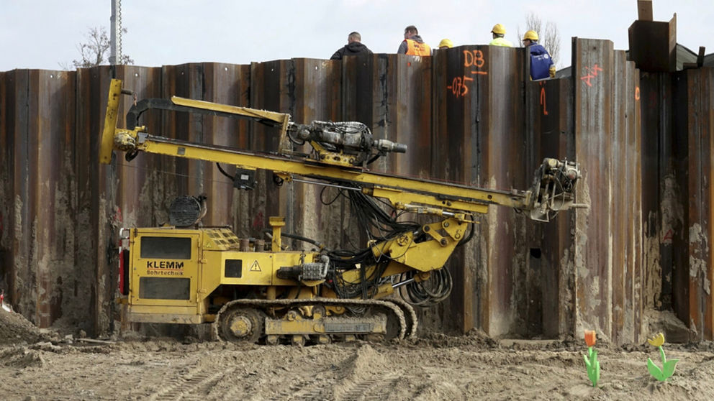
What caused the blackout?
During bridge refurbishment two main power lines have been hit by a horizontal drilling machine.
Quelle: Jörg Bergmann

Slide 3
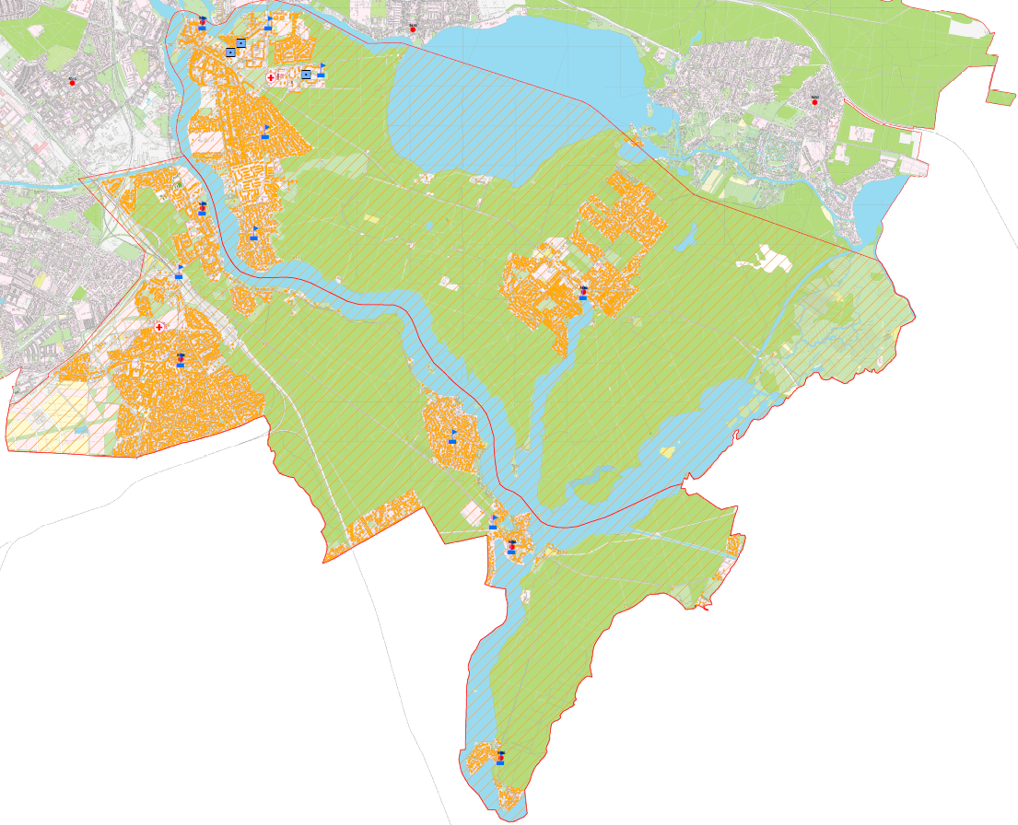
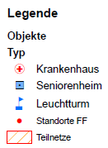
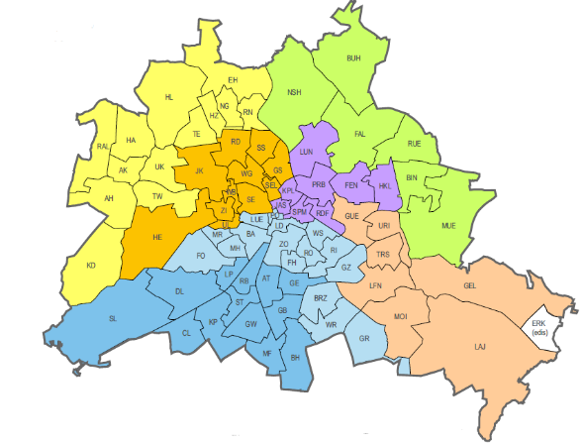
Incident area
Borough Treptow/Köpenick
Area 75 km²
ca. 30.000 households
ca. 70.000 affected persons
ca. 2000 business establishments
2 hospitals
6 Nursing homes
Temperature: between 2 and 10° C
Duration of blackout: > 31 h

Slide 4
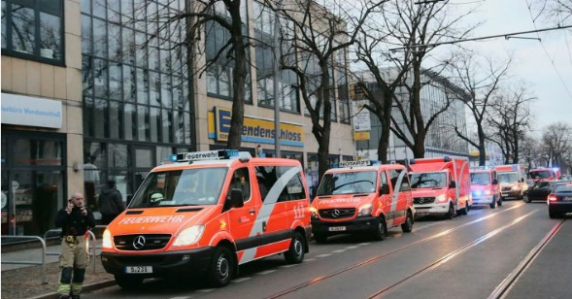
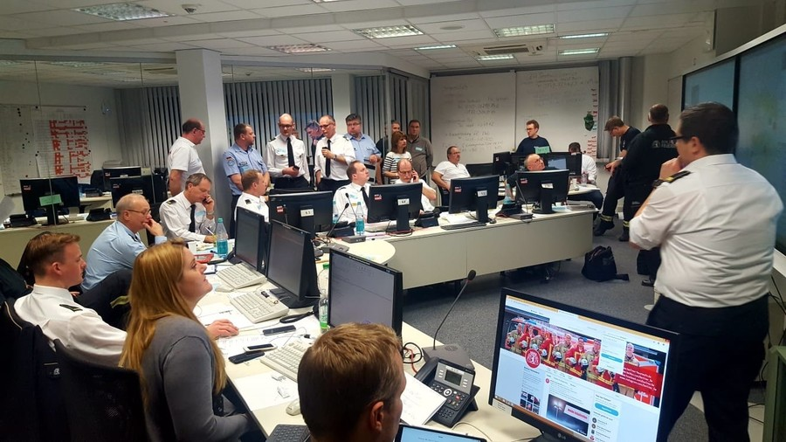
Main challenges 1
Securing ways for emergency calls
Securing the communication for first responders
Keeping the hospitals working
Inform the affected population and give them advice
Confine the boundaries of the affected area
Reconnaissance in the affected area
Establishing of Drop-in centres

Slide 5
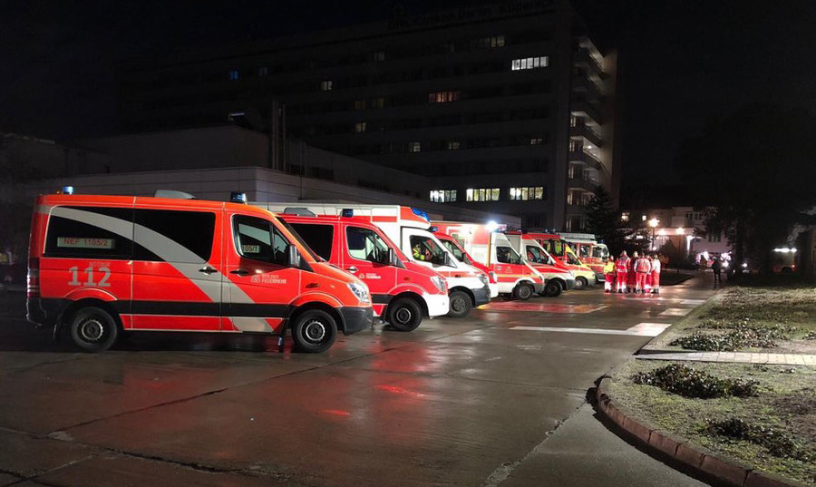
Main challenges 2
Quelle: Berliner Feuerwehr
Emergency power an heating supply for Hospitals and nursing homes
Emergency Inter hospital transfer of 23 intensive care patients
Vulnerable patients
Fire of mobile emergency power generator at an waste water pump station

Slide 6
What went well?
Decision-maker from different stakeholders know each other
Civil protection exercises have trained the emergency structures
Rapid scale up of the command structure
Emergency services are able to improvise
Sending a leading emergency physician to reconnaissance the hospital
Affected people without portable water has been helped quickly

Slide 7
What can be improved?
Need for more mobile emergency power generators
Fuel logistic system for emergency power generators
Need for a civil defence central store
Optimising the citizens capability to help themselves
Contingency plan for vulnerable patients in organised housing
Resources of the Emergency medical services are stretched to the limit on a daily basis

Slide 8
Any Questions?
Thank you very much for you attention!

