Slide 1
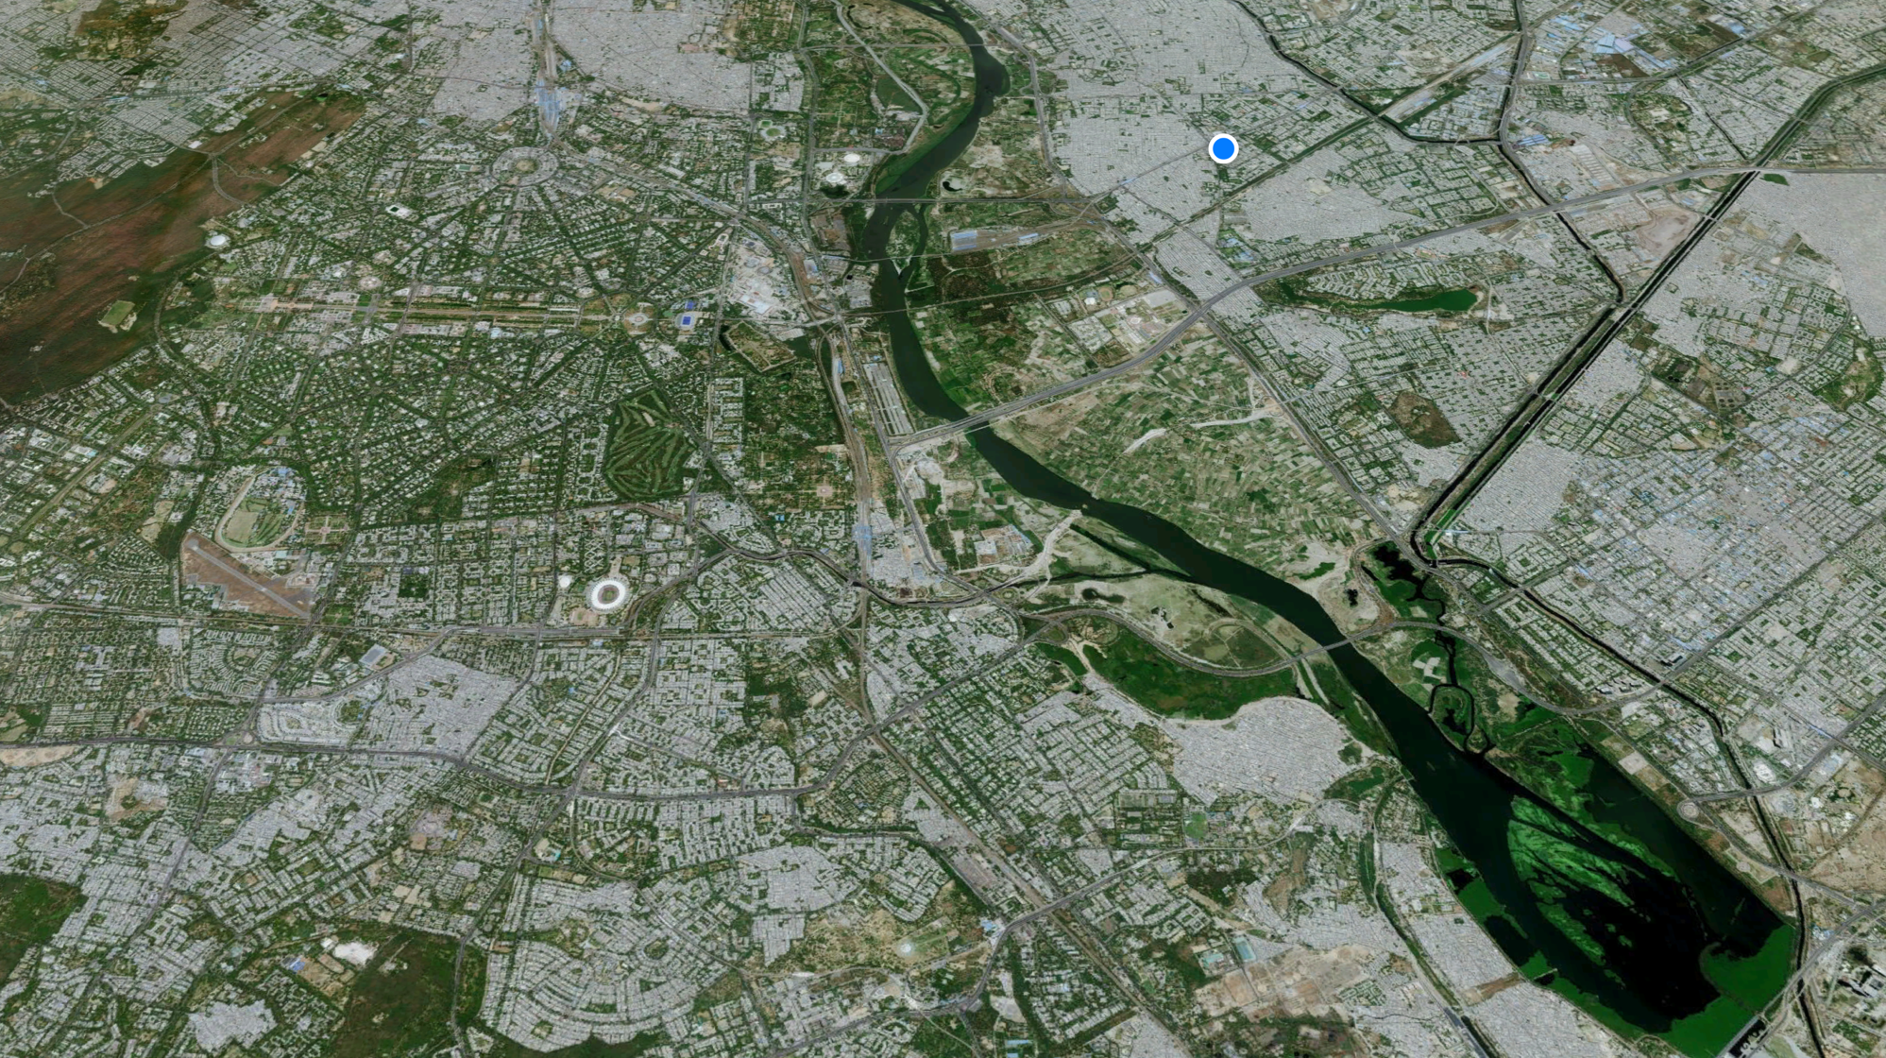
Urban Regeneration
Case: Delhi, India

Slide 2
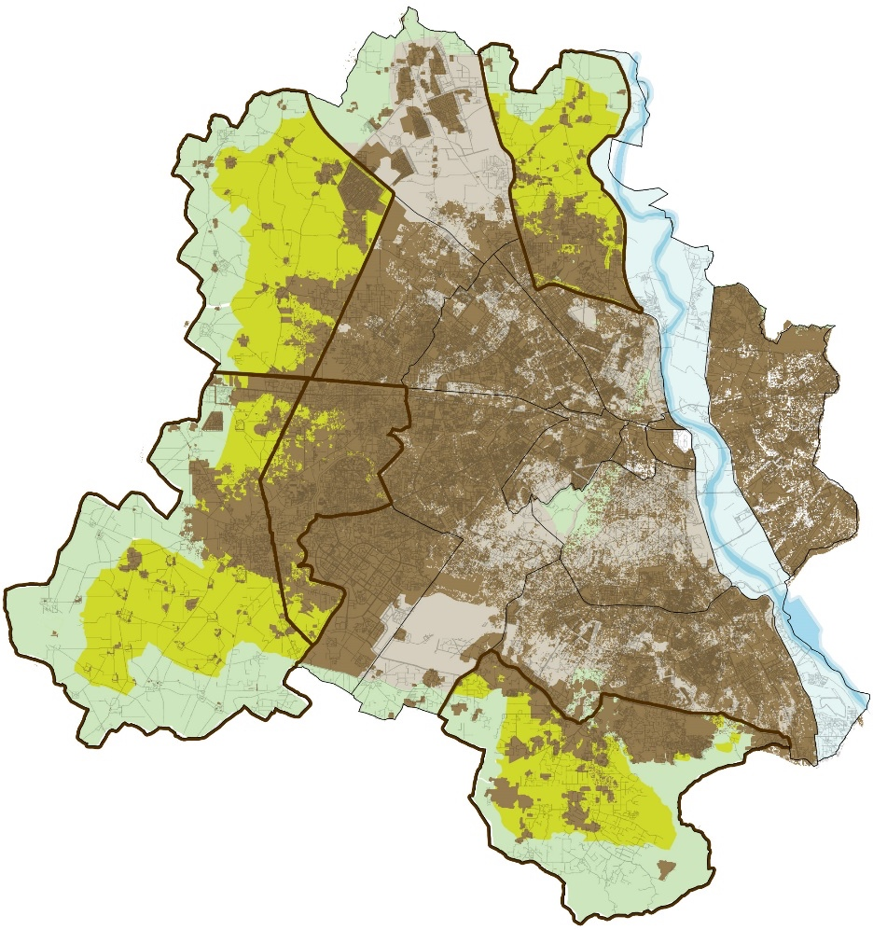
Delhi
Total Area | 1483 sq. km. | Built – 64%
 |  | Open – 36%
Population | 2021 20.6 Million | 2041 29.6 Million
Among the most populous cities in the world 2.26 million migrants had been residing in Delhi (census 2011) 30.3% population is from the age group of 15-30 years (Economic Survey 2019-20), making Delhi one of the cities with the highest young population in the world. | one of the most populous cities in the world 2.26 million migrants had been residing in Delhi (census 2011) 30.3% of the population is from the age group of 15-30 years (Economic Survey 2019-20), making Delhi one of the cities with the highest young population in the world.

Slide 3
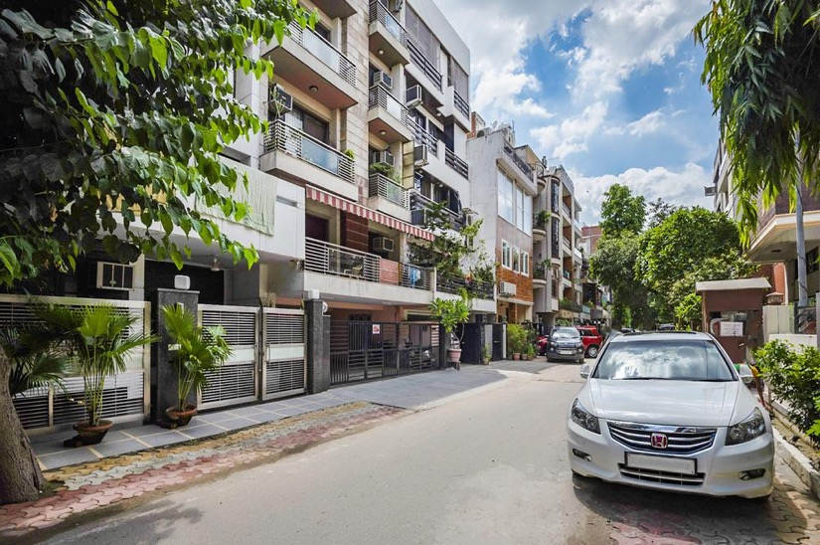
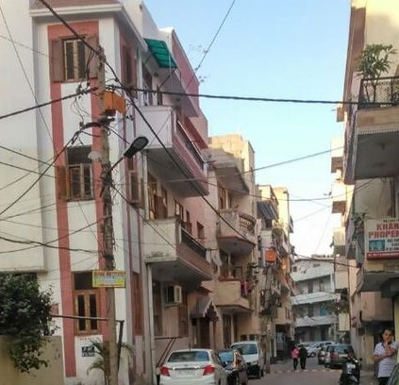
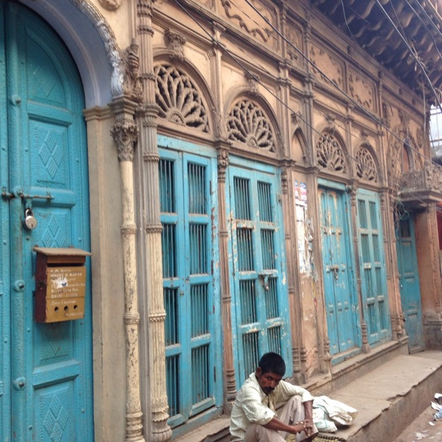
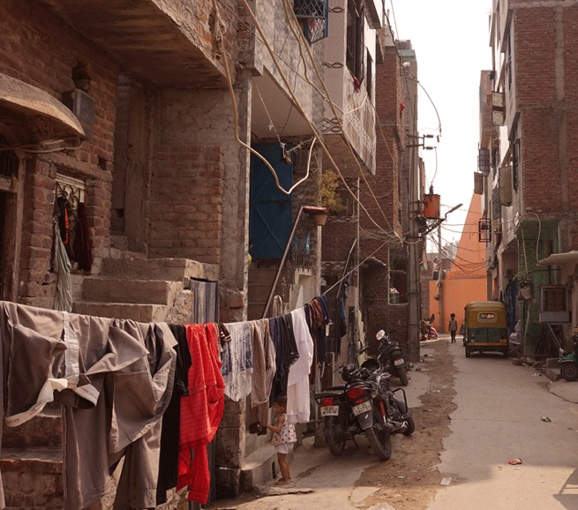
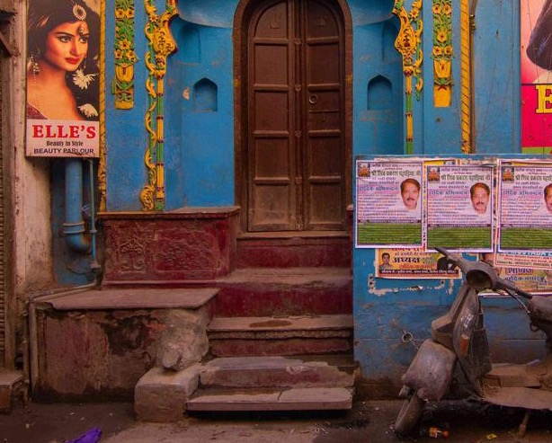
Residential Areas

Slide 4
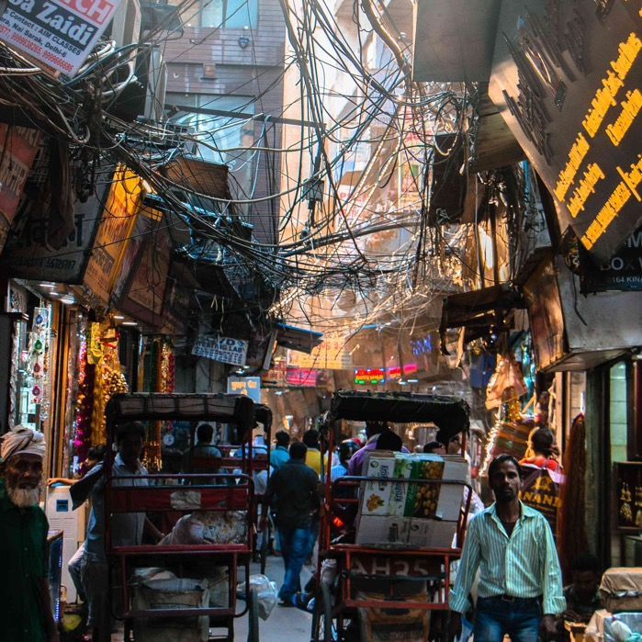
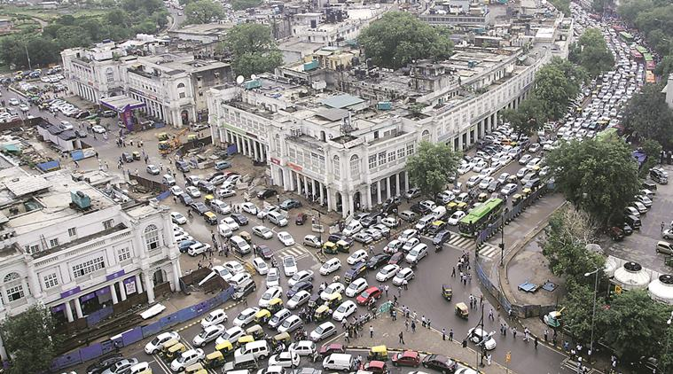
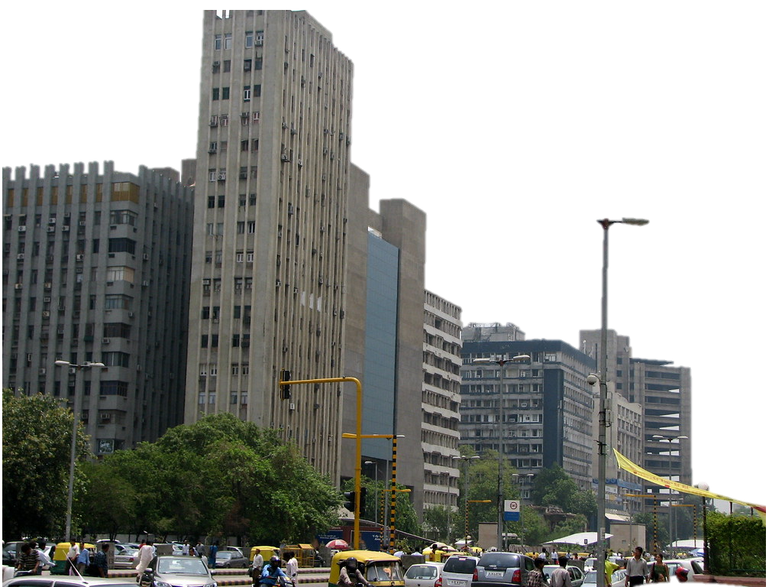
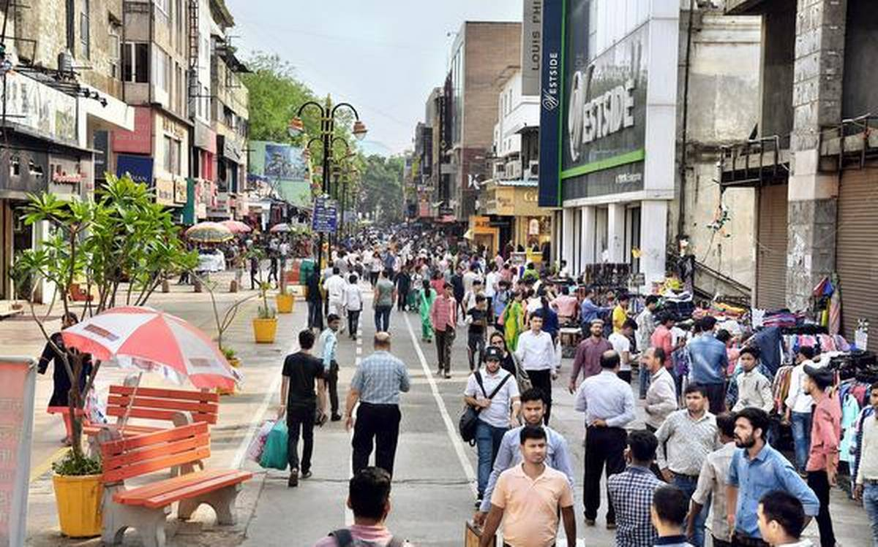
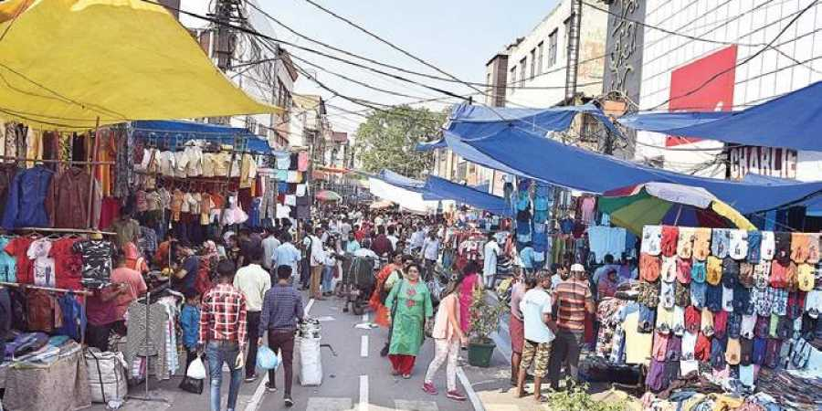
CBD and markets of Delhi

Slide 5
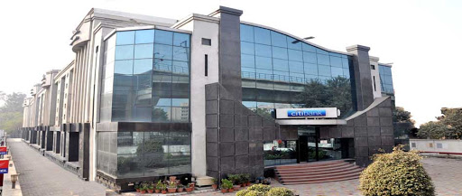
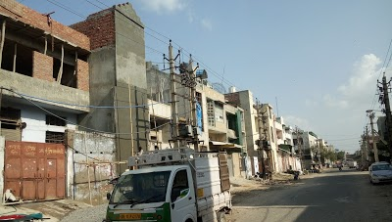
Industrial Areas

Slide 6
Regeneration: Targeted Outcomes
IMPROVE QUALITY OF LIFE
Address issues of congestion, age, structural safety, disaster resilience and improve public facilities
FACILITATE SUSTAINABLE BUILT ENVIRONMENT
Improve greening, sustainable urban services, energy efficiency, green mobility, etc.
MAXIMISE POTENTIAL OF STRATEGIC AREAS
Build upon locational advantages, economic revival. new hubs

Slide 7
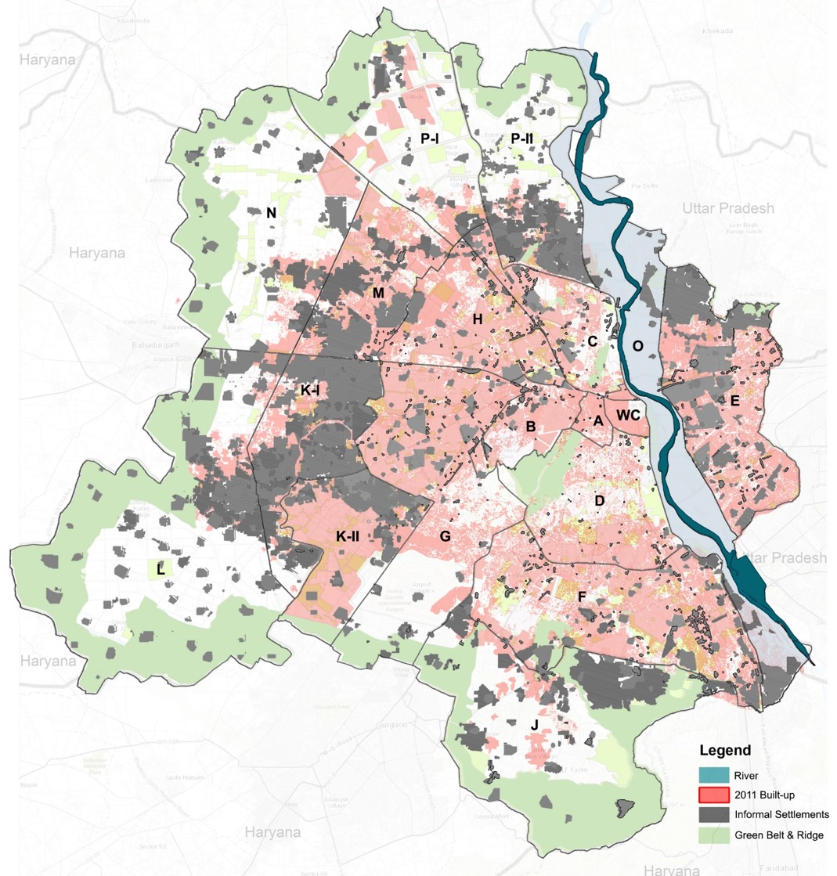
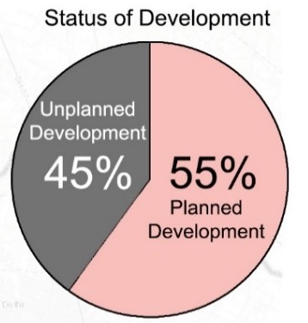
Challenge: The Existing Built Fabric
Group Housing | Plotted Housing | Employer Housing | Slum Resettlement & Rehab | Planned Residential Areas
Patparganj, Janakpuri DDA Housing, Vasant Kunj DDA Housing | DDA Plotted Housing, Refugee Colonies – Lajpat Nagar, Rajori Garden, etc. | Local body housing, DMRC, DDA employee, GPRA, etc. | Kalkaji Extension, Khichripur, etc.
Urban Villages | Unauthorised Colonies | Slums and JJ Clusters |  | Un-Planned Residential Areas
Mehrauli, hauz khas, Shahpur Jat | Kishangarh, Shahdara, Uttam Nagar | All notified clusters
Un-Planned Or Pre-DDA Markets / Industrial Site | Planned Commercial & Industrial Centers | CBD | Other Planned Areas | Economic Centers
Meharchand, Khan Market, Lajpat, Shazadabad, Anand Parvat | NFC, GK II M-Block Market, Bawana, Narela, Kirti Nagar | CP, Old city, Paharganj, Daryaganj, Karol Bagh, Barakhamba | Okhla, Qutub Institutional Area
Heritage Districts |  |  |  | Historic/ Cultural Districts
Culturally Significant Districts
Health and Education PSP Facilities
STATUS OF BUILT-UP AREA

Slide 8
Regeneration: Key Highlights
1
2
3
4
FLEXIBLE & NUANCED
OUTCOME LINKED
INTEGRATED PLANNING
STRATEGIC
‘Regeneration’ not ‘Redevelopment’ – wider definition including retrofit, reconstruct and partial/full redevelop
Type-wise strategies for area improvement, regeneration plans and schemes
incentives such as FAR or relaxed norms/ charges on the condition that the project will fulfill linked to public purpose such as creation of new public spaces and parks, sustainable development etc..
amalgamation and reconstitution of plots to achieve better integrated planning, creation of well-proportioned open spaces, improvement of road networks and incorporation of site level sustainability features.
No point in spreading the Regeneration incentives across the city
Prioritize target areas like very old neighborhoods, strategic areas
Use Regeneration as a way to rejuvenate economic hubs
5
SCALE OF PROJECTS – LOCAL PARTICIPATION AND URBAN DESIGN

Slide 9
2. Outcome Linked
Link FAR and other incentives to:
age
public outcomes like public space, greening initiatives, decentralized infrastructure, etc.
desired economic, cultural outcomes
OVERALL FAR LOGIC
1.5X – 500FAR
- Jobs and homes close to transit
- Major mix use hubs of the city
1.55 - 1.8X MPD
- Amalgamation
- SUS factor
- Promotion of specific use/ activity
1.35 - 1.5X MPD
- Age
- Amalgamation
- SUS factor
1.25 - 1.4X MPD
- Amalgamation
- SUS factor
FAR INCENTIVES
MPD permissible FAR
Plot reconstructions
General regeneration
Regeneration of
old areas
BPD
TOD
NUMBER OF SITES

Slide 10
4. Strategic Approach
TRANSIT-ORIENTED DEVELOPMENT
BUSINESS PROMOTION DISTRICTS
Limited TOD nodes providing high density of jobs and workplaces close to public transit
Strategic Locations treated as incubation clusters with concentration of clean service-based industries
Strategic areas and regional entry points to support logistics, hospitality, and creation of medi-cities or edu-cities.
These will act as gateways
Higher regeneration FAR provided for promoting clean economic sectors like IT/ITES, knowledge and R&D, creative industries, modern logistics
Under-utilised commercial and Industrial Sites

Slide 11
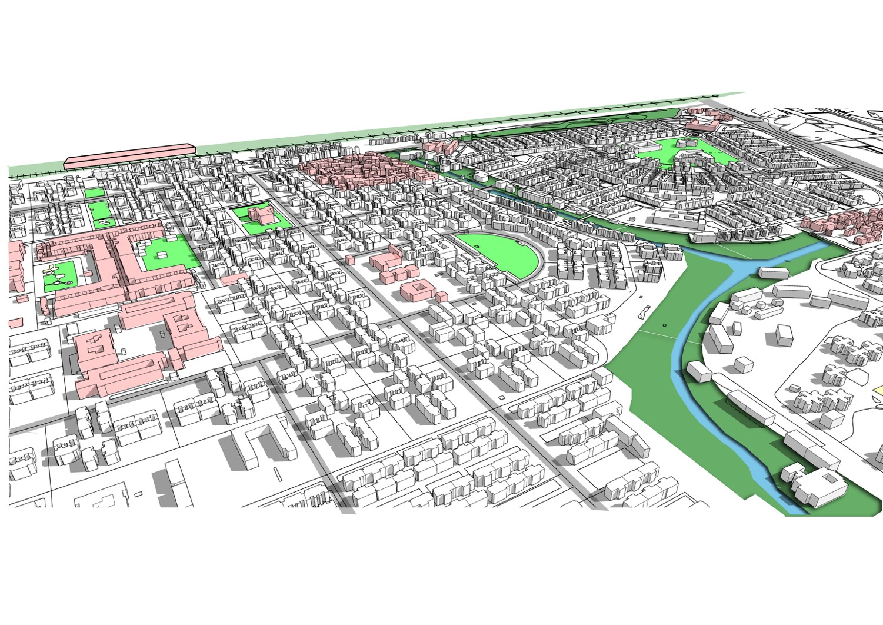
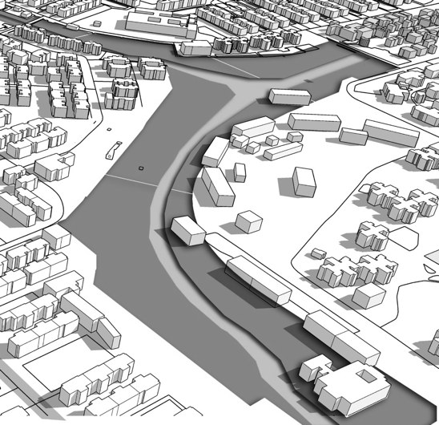
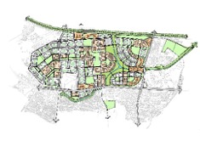


3. Integrated Design Approach
Existing Institutions
Sanjay Lake
Disconnected greens
Dilli Haat
Sarojini Market
Existing nallahs
Transformation of the HIGH STREET

Slide 12
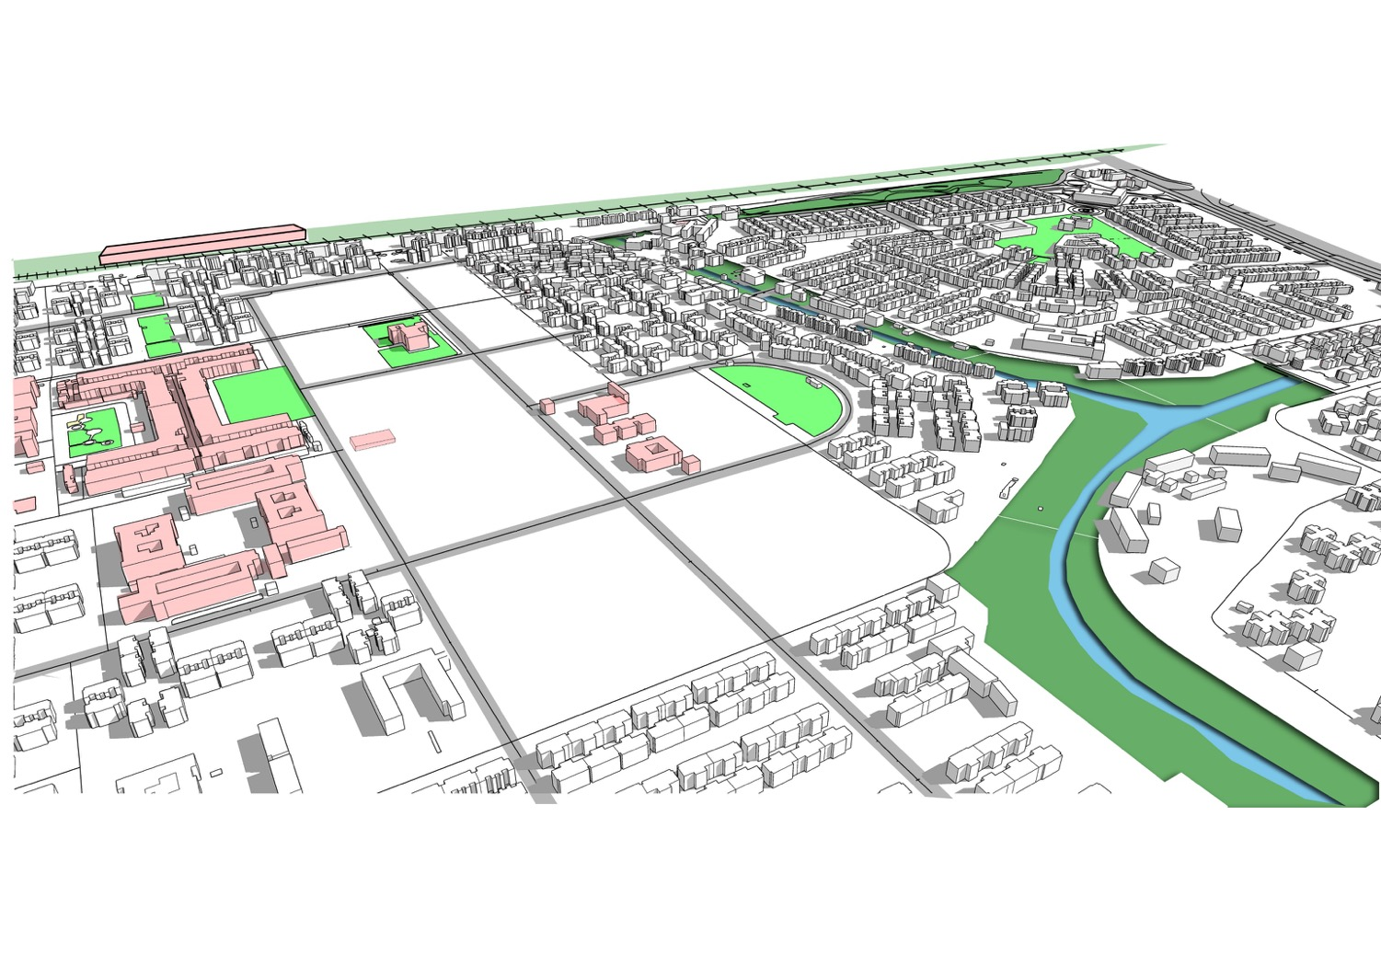
3. Integrated Design Approach
Open up spaces around metro station
Rejuvenated city-level public green
Sarojini Metro station
Stage 1: Transformation of Market precinct;

Slide 13
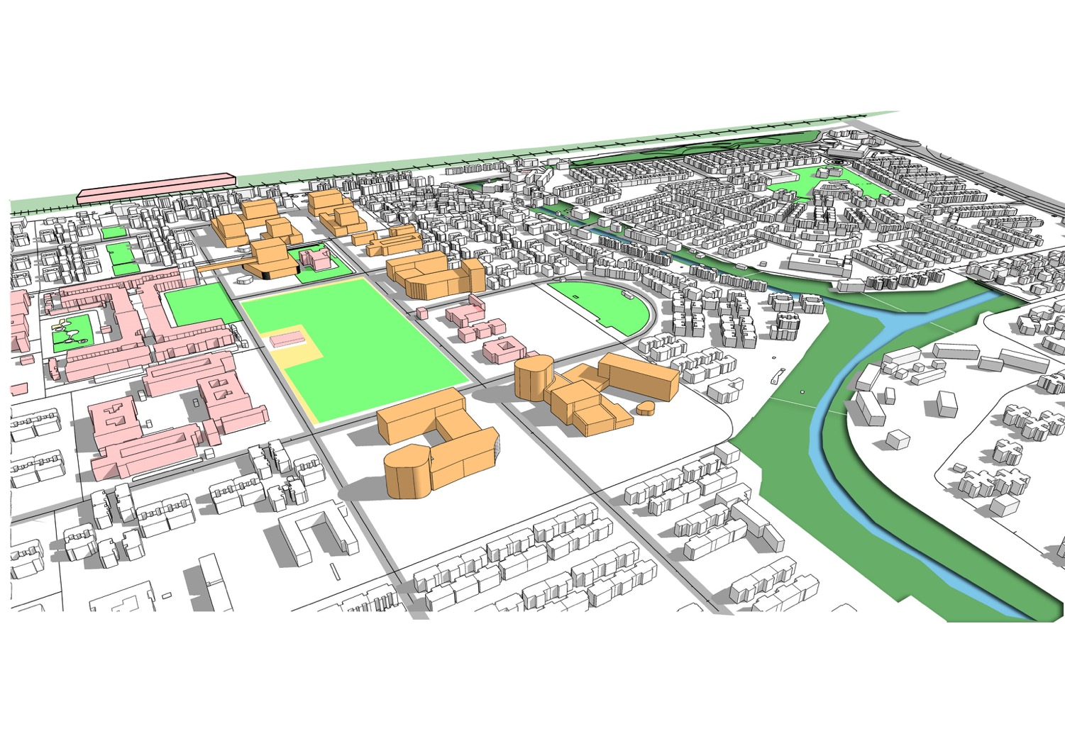
3. Integrated Design Approach
Cultural/public space around metro station
Spill-over for Sarojini Market
Mixed use corridor
Sarojini Market
Rail station
Metro station plaza
Stage 2: Developing new commercial/ cultural precinct;
Existing Commercial/ PSP buildings
New Commercial/ PSP/ Cultural buildings

Slide 14
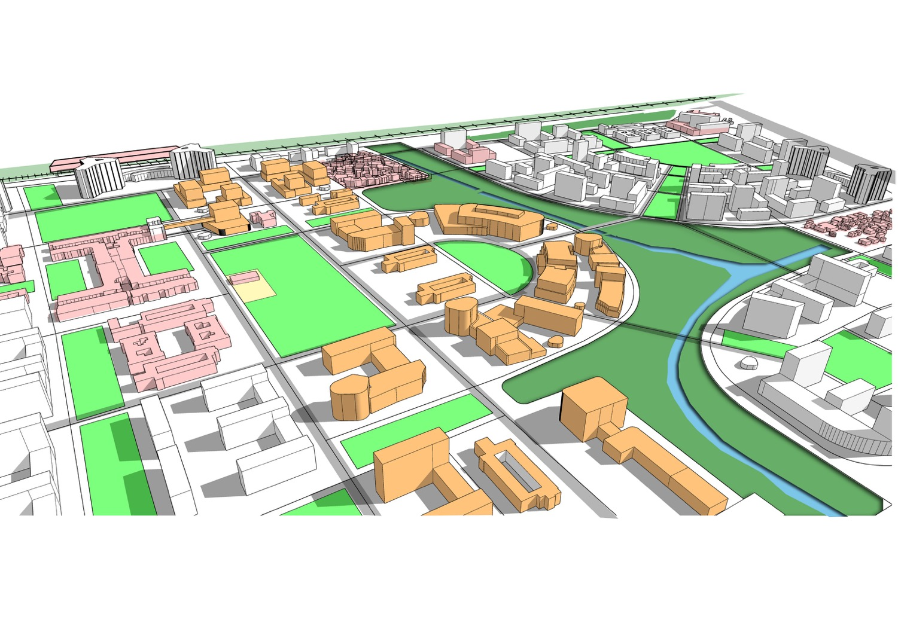
3. Integrated Design Approach
Walkable link – Eco-Park
Connecting Sarojini cultural hub to Delhi Haat
Cultural Hub
Cultural institutions that can open up to the Eco Park
Walkable green linkages to Sanjay Lake
Stage 4 : Developing new city-level leisure precinct; Developing new housing areas;
Existing Commercial/ PSP buildings
New Commercial/ PSP/ Cultural buildings

Slide 15
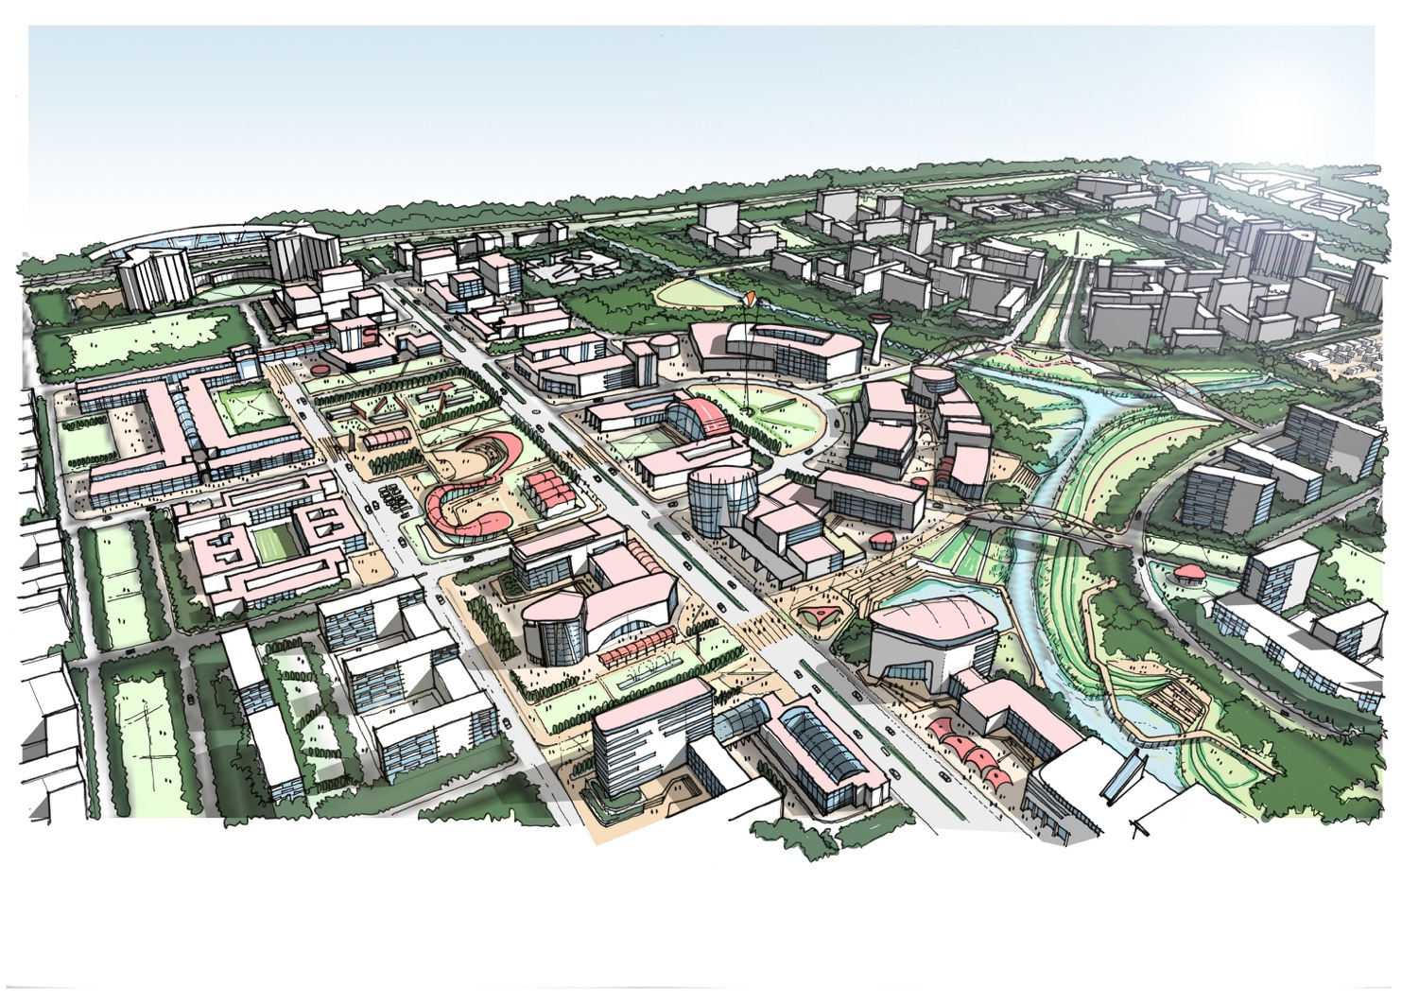
3. Integrated Design Approach
The transformed ECO CORRIDOR AND CULTURAL HIGH STREET

Slide 16
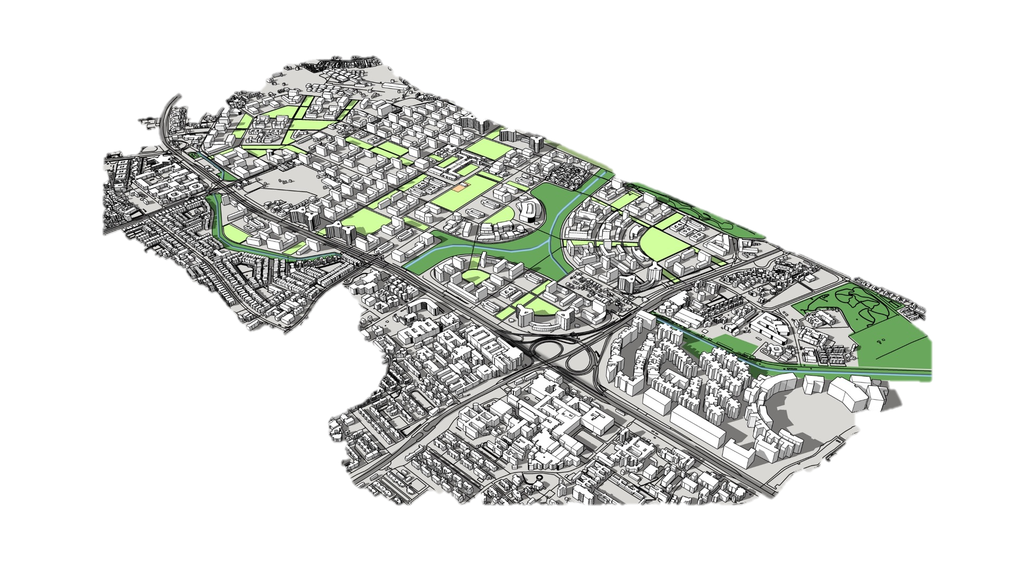
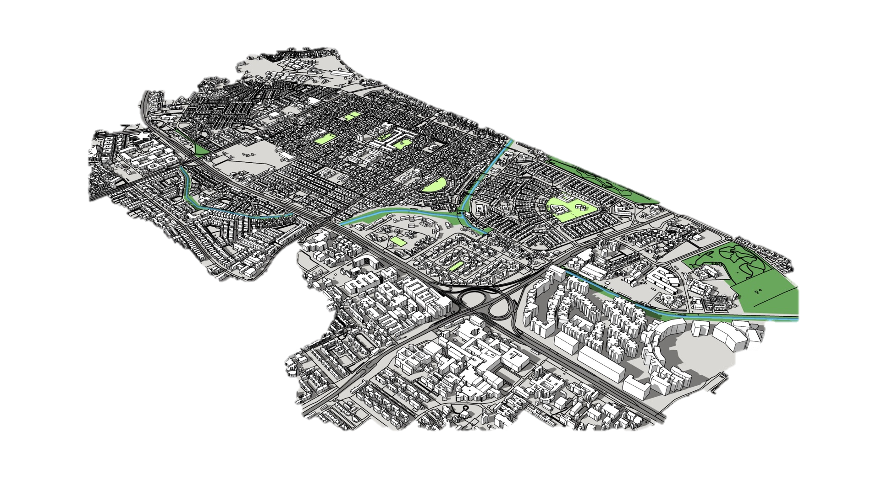
3. Integrated Design Approach

Slide 17
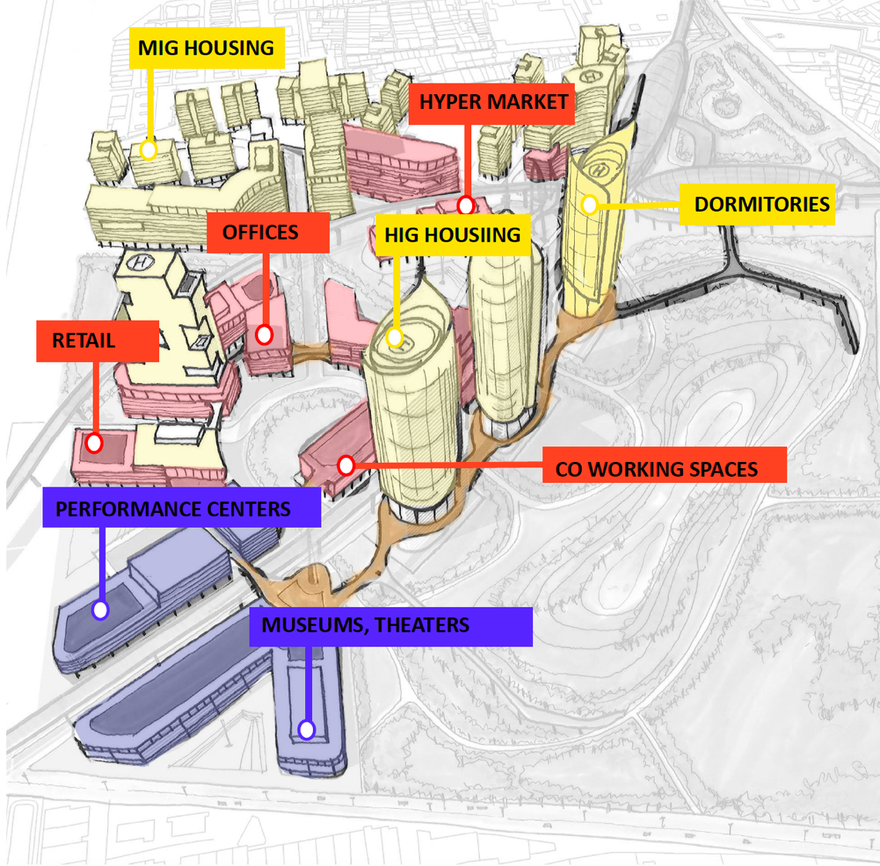
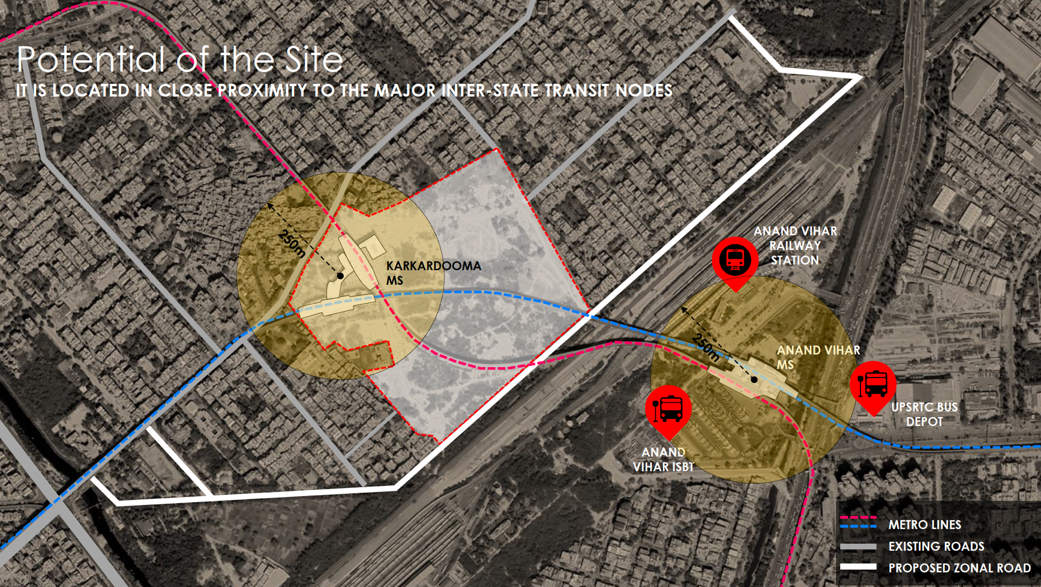
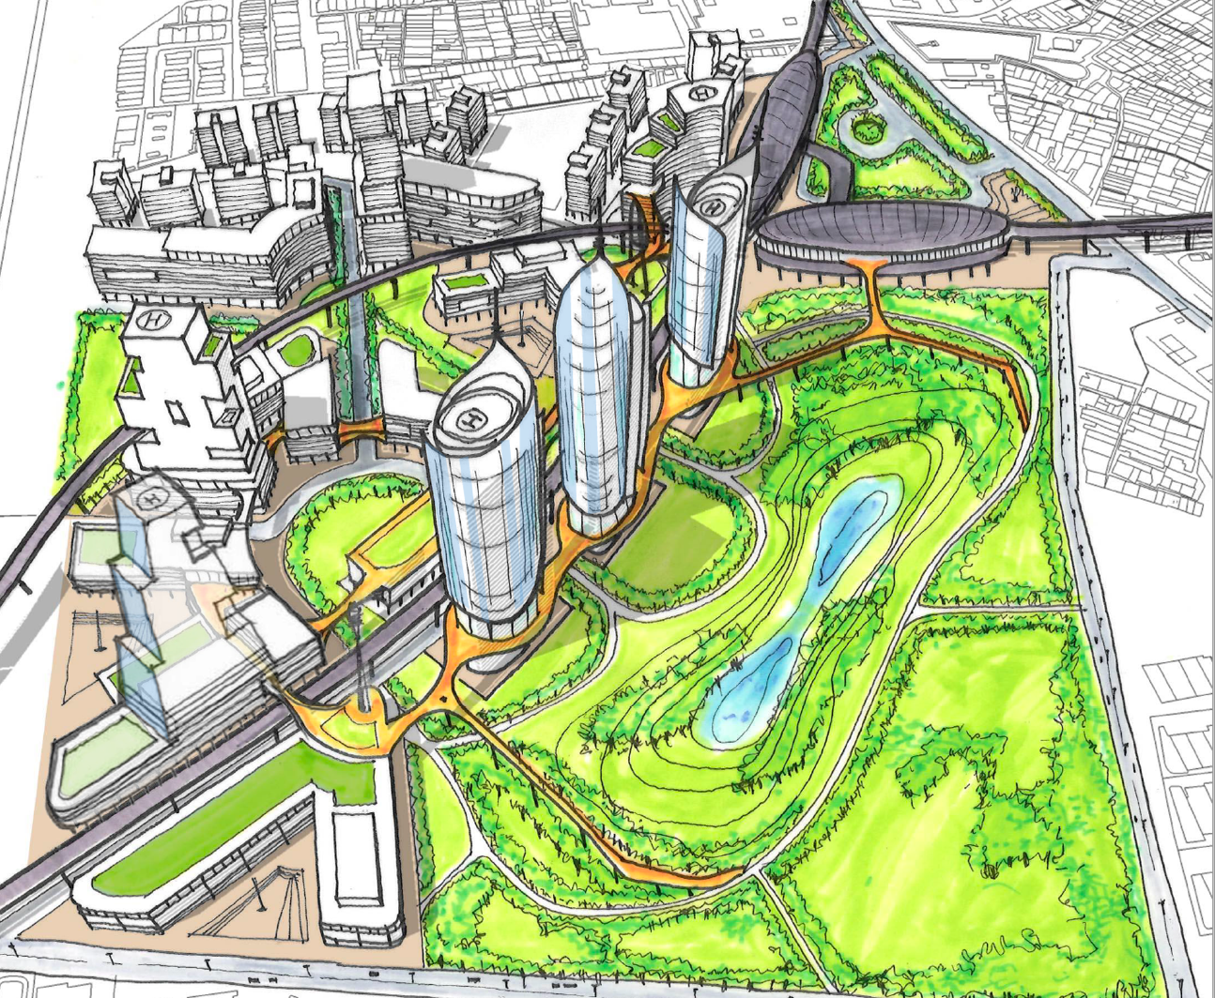
4. Strategic Approach
Unlocking Greens and Economic Hub for the East District

Slide 18
Thank You

